Slide 1


Air Force Institute of Technology
NENG 791 – Proliferation of Weapons of Mass Destruction
Safeguards: Destructive and Nondestructive Analysis
Lt Col Fee
E d u c a t i n g t h e W o r l d ’s B e s t M i l i t a r y
Notes:
These slides were taken from a presentation developed primarily by Dr. David Chichester. They were developed through a multi-institution collaboration with funding provided by the Global Threat Reduction Initiative specifically for export to other academic institutions to improve the nuclear security instruction provided as part of their undergraduate and graduate nuclear education programs.

Slide 2
IAEA Regular Budget for 2014
Regular Budget 2014 |  | Euro (€)
1. | Nuclear Power, Fuel Cycle and Nuclear Science | 34 861 971
2. | Nuclear Techniques for Development and Environmental Protection | 38 888 632
3. | Nuclear Safety and Security | 37 555 701
4. | Nuclear Verification | 132 540 092
5. | Policy, Management and Administration Services | 77 687 366
6. | Management of Technical Co-operation for Development | 23 797 704
 | Subtotal for Major Programmes | 345 331 466
7. | Reimbursable Work for Others | 2 845 593
TOTAL |  | 348 177 059
Notes:
IAEA Regular Budget for 2015
The IAEA Regular Budget for 2014 amounts to € 344 million.
The target for voluntary contributions to the Technical Co-operation Fund for 2014 is US $90 million.

Slide 3
The IAEA’s Challenge
As of 2006, 925 facilities were under IAEA Safeguards
Safeguarded Nuclear Material (excluding source material)
980 metric tons Pu (mostly spent fuel), 16 MT HEU, 1120 MT LEU
“The IAEA should be able to provide credible assurance not only about the declared nuclear material in a State but also about the absence of undeclared materials and activities.”
Primary safeguards goal is the timely detection of a diversion of a significant quantity.
What are the two types of diversion?
Notes:
What are the two types of diversion?
Abrupt diversion—the immediate diversion of a SQ or greater in a short time (typically a conversion period, about 2 weeks to a month)
Protracted diversion—the diversion of portions of a SQ over extended periods of time leading to a SQ or greater (typically an inventory period, about 6 months to a year)

Slide 4
Destructive Analysis
What is destructive analysis (DA)?
With DA, do we lose the important sample attributes in the remaining materials?
Notes:
What is destructive analysis?
DA involves quantitative radiochemistry and nuclear chemistry methods for determining the elemental composition, elemental assay, or isotopic composition of a sample.
As suggested by the name, in DA all or part of the sample is consumed in analysis
In most cases, the material analyzed cannot be recovered (e.g. it is volatalized)
DA irreversibly alters the physical structure of a sample
e.g. Dissolved or radiochemically purified
Destructive analysis does not necessarily result in the loss of important sample attributes in the remaining materials
Analysis may be separated from a matrix but isotopic composition, elemental impurity characteristics may still be preserved
DA techniques are remarkably sensitive, often only very small samples are needed
Information on destructive analysis techniques presented here has been adapted from “Destructive Analysis Techniques for Safeguards,” Stephen LaMont et al, LANL (2009)

Slide 5
Examples of DA Techniques
Elemental Assay Methods
Titration
Elemental Composition Assay Methods
Atomic emission spectroscopy, mass spectrometry
Isotopic Analysis Assay Methods
Mass spectrometry, Alpha spectrometry, radiochemical gamma-ray spectroscopy, Radiochemical alpha/beta-particle spectrometry (with liquid scintillation counting)
Traditional Safeguards
SNM accountability,
Assay, isotopic, and impurity measurements are critical for accurate counting
Environmental Safeguards
Swipe sampling in safeguarded facilities (isotopic and assay measurements)
Verification of declared operations, detection of undeclared operations

Slide 6
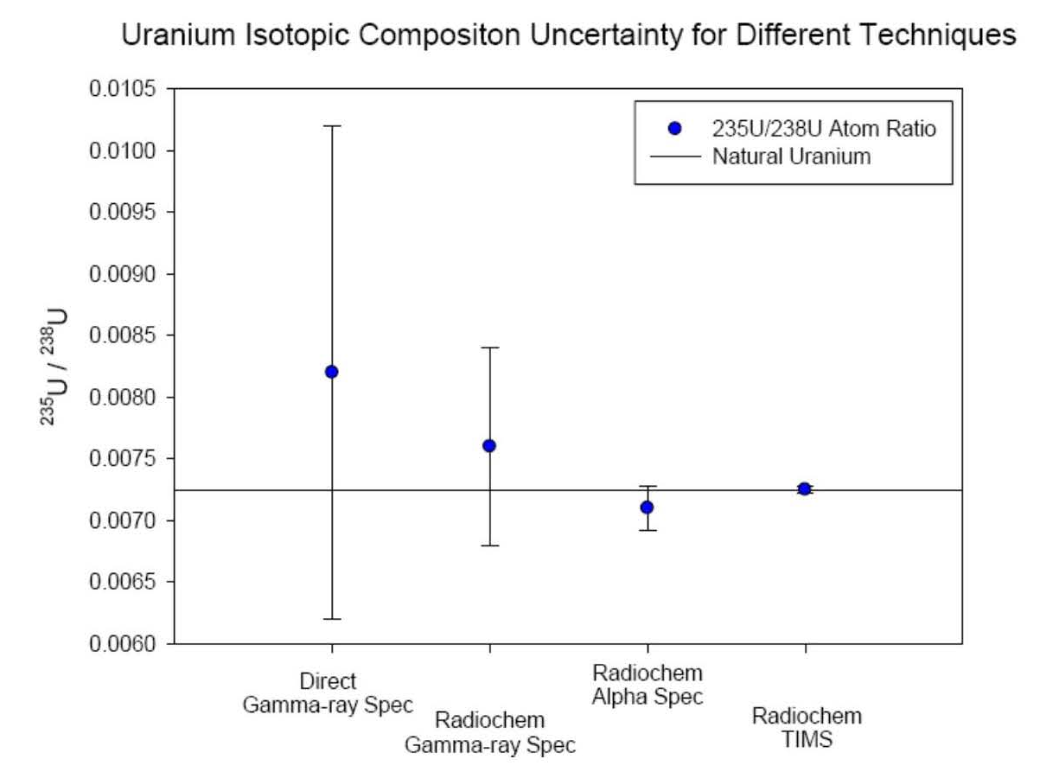
Strengths of DA Techniques
Precision
Why is DA more precise than non-destructive assay (NDA) methods?
Assay Detection limits
Why are assay detection limits of DA measurements usually lower than with NDA measurements?
Notes:
The precision of DA measurements is usually much better than with non-destructive assay (NDA) methods
Matrix effects can be eliminated or corrected
Interferences can be removed
Assay detection limits of DA measurements are usually lower than with NDA methods
DA can generally eliminate background signals from the matrix / measurements
DA techniques are generally more sensitive because of the basic method (e.g. atom counting vs activity counting)
TIMS—Thermal Ionization Mass Spectrometry shown here

Slide 7
Weaknesses of DA Techniques
Why are DA measurements typically more labor intensive than NDA measurements?
How does preparation of DA samples introduce opportunities for error?
Why are DA analysis methods more expensive than many NDA techniques?
Notes:
Why are DA measurements typically more labor intensive than NDA measurements?
Sample preparation can take days to complete
Legal “Chain of Custody” controls are difficult
Off-site sample processing (shipment to Vienna) can delay results by months.
How does preparation of DA samples introduce opportunities for error?
Careful attention must be given to avoid cross-contamination of samples
Why are DA analysis methods more expensive than many NDA techniques?
Specialized instruments and facilities can be very expensive.

Slide 8
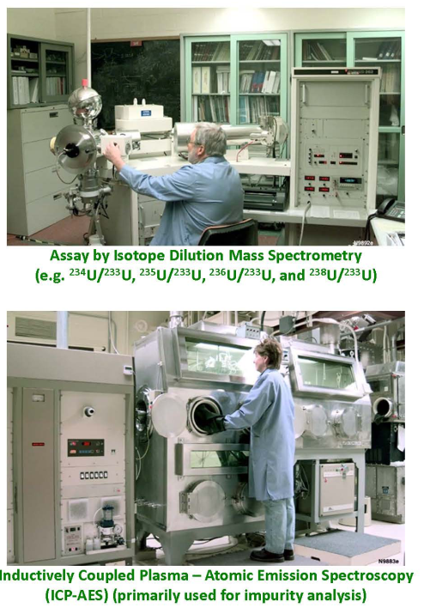
Typical Destructive Analysis Applications
Two different scenarios:
Facility safeguards—large samples (grams to milligrams)
Environmental sampling—small samples (milligrams to nanograms)
Determinations:
Uranium and plutonium accountability
Mass
Enrichment
Isotopic composition (e.g. TIMS)
Impurity analysis
Age dating (radiochemistry)
Process history
etc.

Slide 9
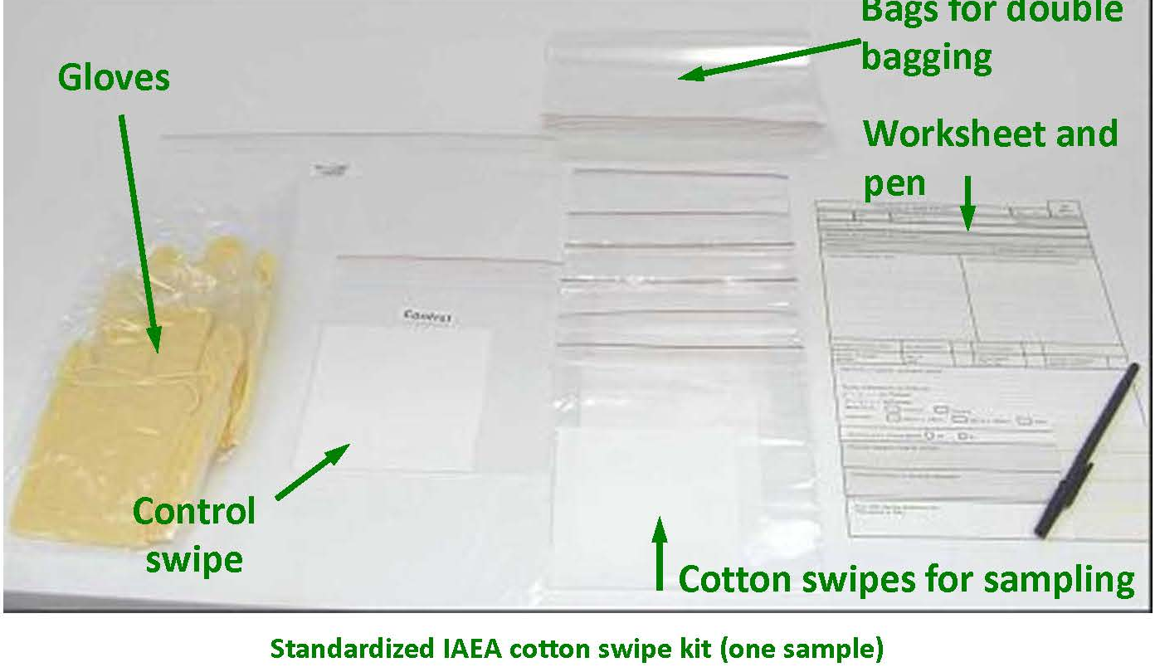
DA for IAEA Environmental Samples
Environmental safeguards sampling and analysis is a powerful method for verifying declared operations at safeguarded facilities
Analyses are completed at the IAEA Network of World Analytical Laboratories
Notes:
Sample collections:
Collect environmental sample (swipe)
NDA gamma spectroscopy
Uranium assay by ICP-MS or ID TIMS isotopics by TIMS
Plutonium assay and isotopics by ID TIMS
Rigorous QA program
Process blanks with each set of samples
Blind QC samples analyzed at least once per year

Slide 10
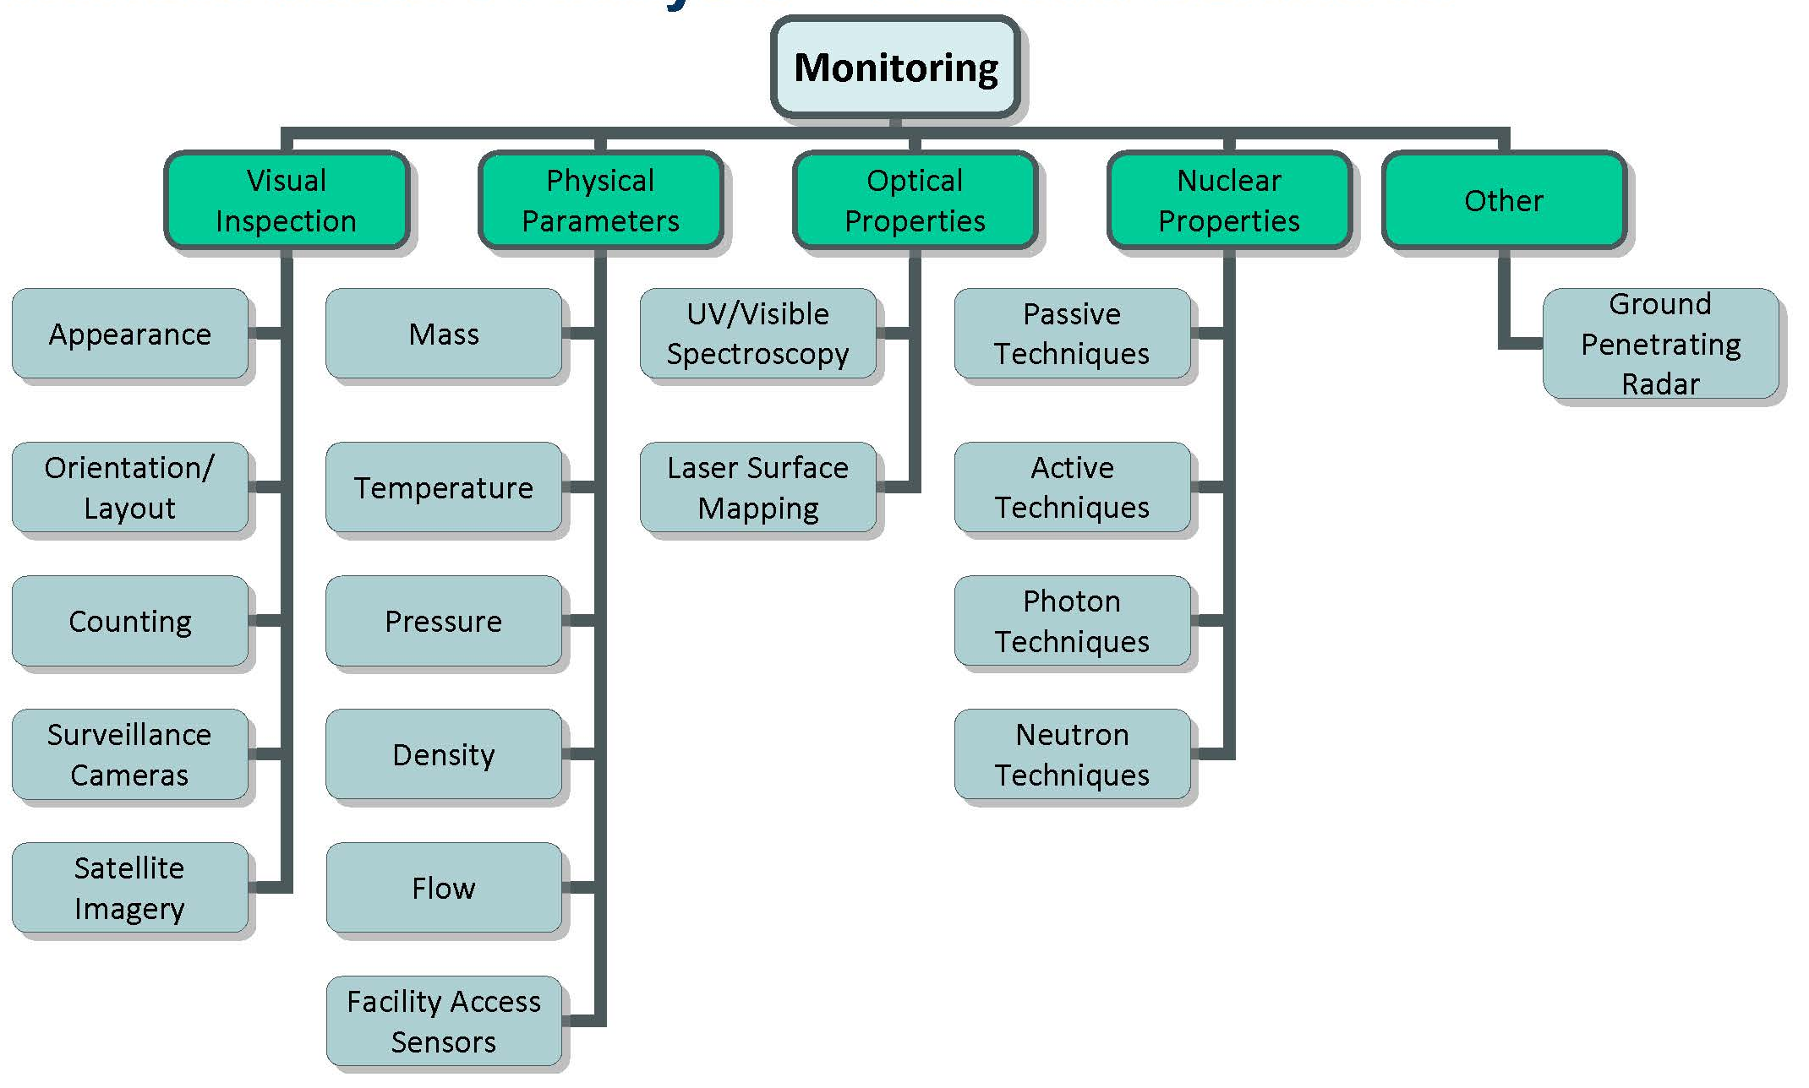
NDA: A Broad Definition

Slide 11
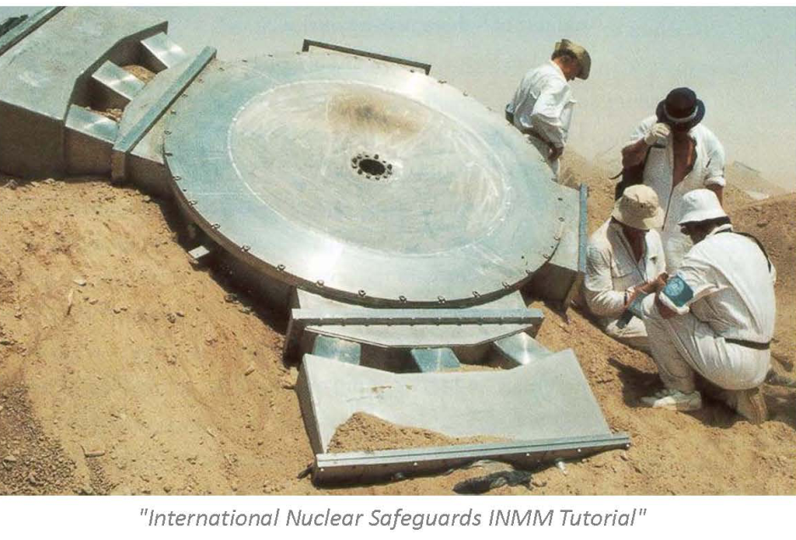
Visual Inspections
What are they?
This photo was taken in the Iraqi desert after the 1991 Gulf War. It shows inspectors examining a component of an EMIS which was part of a covert Uranium enrichment program unknown prior to the war
Notes:
What are visual inspections?
They are straightforward, labor intensive, and expensive.
They are perhaps the most commonly performed type of safeguard assessments.
Visual observation by skilled and knowledgeable inspectors is a key part of safeguards.
However, visual inspections are not foolproof and misdirection, obfuscation, concealment, and other methods of deception can limit the overal usefulness of visual inspections in many cases.

Slide 12
Simple Counting
Can you provide some examples of simple counting (i.e. what kinds of things might you count)?
Notes:
Examples of simple counting:
Fuel pins, rods, assemblies, canisters
UF6 containers
Waste storage containers
Pipes, valves, etc…

Slide 13
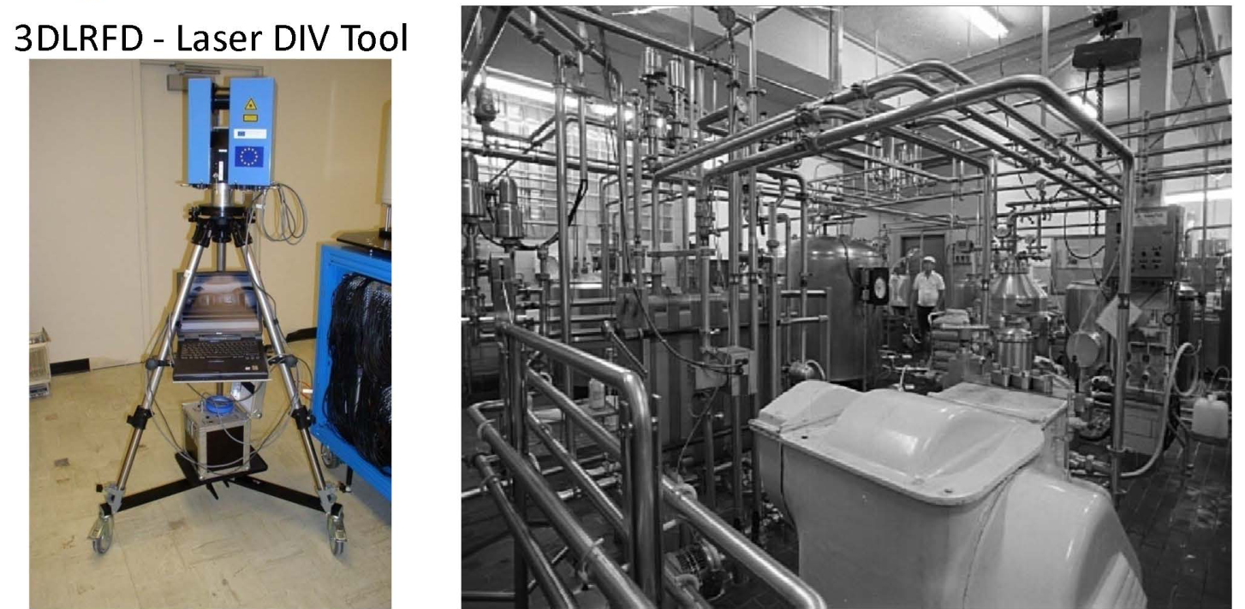
Design Information Verification
Notes:
Nuclear processing facilities can be very complex. Can you imagine trying to find a change in the facility shown to the right?
DIV confirms a facility is laid out to achieve the declared task(s) and nothing more.
Next generation “change detection” tools can help identify modifications after the initial DIV.

Slide 14
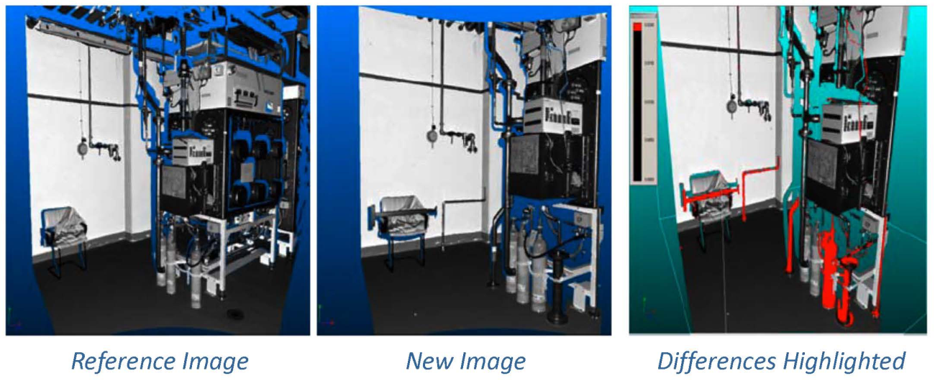
DIV Example
Technology sure can make life easier…
Notes:
Date here shows changes in a facility and its equipment detected using the 3DLRFD (3DLR) system.
The red points indicate objects that have shifted position beyond a set tolerance level

Slide 15
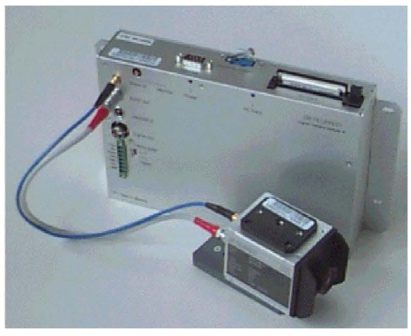
Surveillance Cameras
Current IAEA surveillance systems are based on the DCM14 digital camera module. Capabilities / characteristics:
Scene change detection
Image compression
Image/Data authentication & encryption
Power management & battery back-up
External triggers
State of health
Removable image and data recording media
What kinds of things is surveillance used to detect?
Notes:
What kinds of things is surveillance used to detect?
Detect and/or confirm all movements of nuclear material and spend fuel containers
Confirm that containment is maintained
Confirm that information related to locations and quantities of nuclear material is valid
Confirm IAEA devices are not tampered with
Ensure the absence of undeclared operations
Continuously monitor a specific activity for a short period of time
As with nearly all safeguard instrumentation, the cameras used for monitoring and surveillance are specialized and custom made:
Tamper resistant / tamper indicating
Data authentication
Self-powered
Redundancy

Slide 16
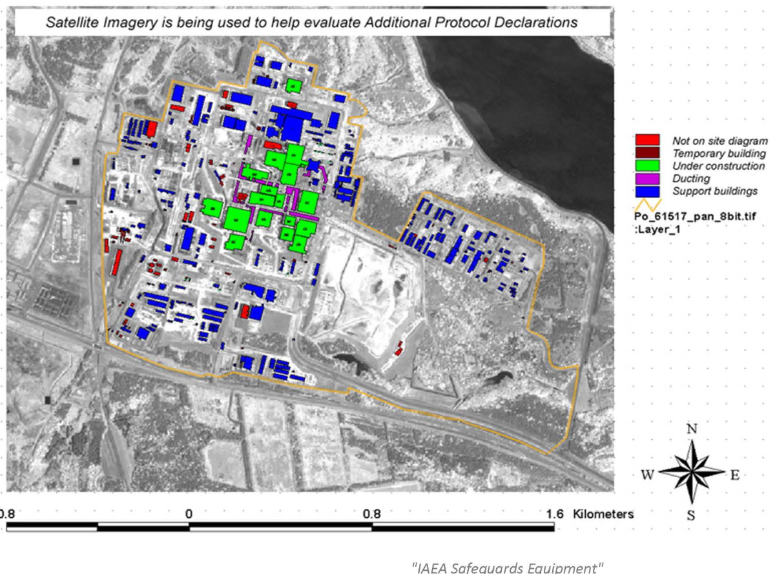
Satellite Imagery
Notes:
Red—not on the site diagram
Maroon—temporary building
Green—under constructing
Purple—ducting
Blue—support buildings

Slide 17
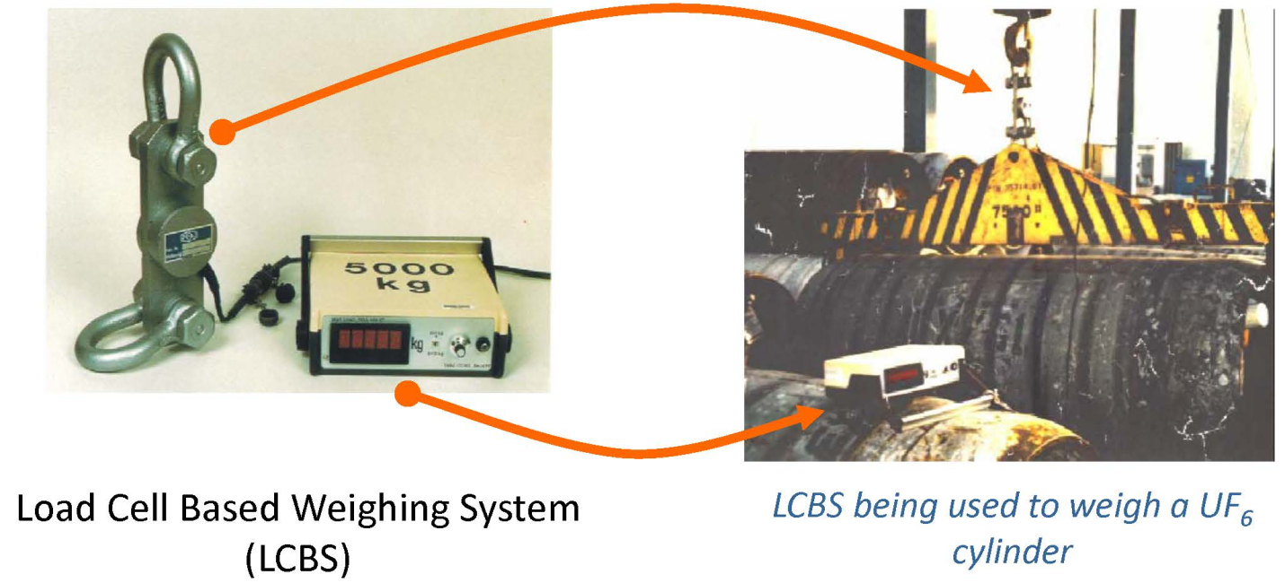
Physical Parameters: ”Simple Mass Measurements”

Slide 18
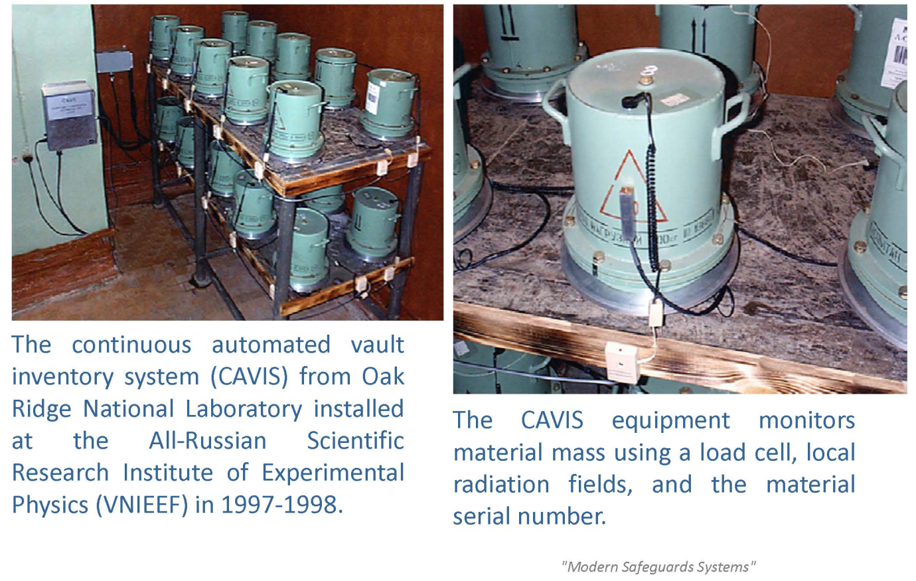
Monitoring Materials in Storage

Slide 19
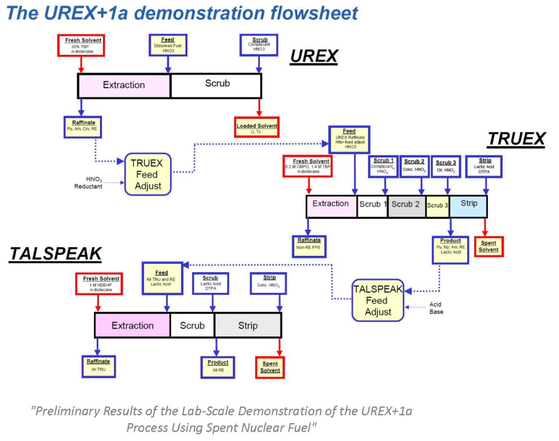
Process Monitoring: Mass, Temperature, Pressure, Density, Flow
Notes:
Many measurement opportunities exist within the entire nuclear fuel cycle including during mining, enrichment, fuel fabrication, spent fuel reprocessing, waste disposal, and all of the steps in between these processes.
Traditional industrial control system measurements can be used for both process quality and safeguards.

Slide 20
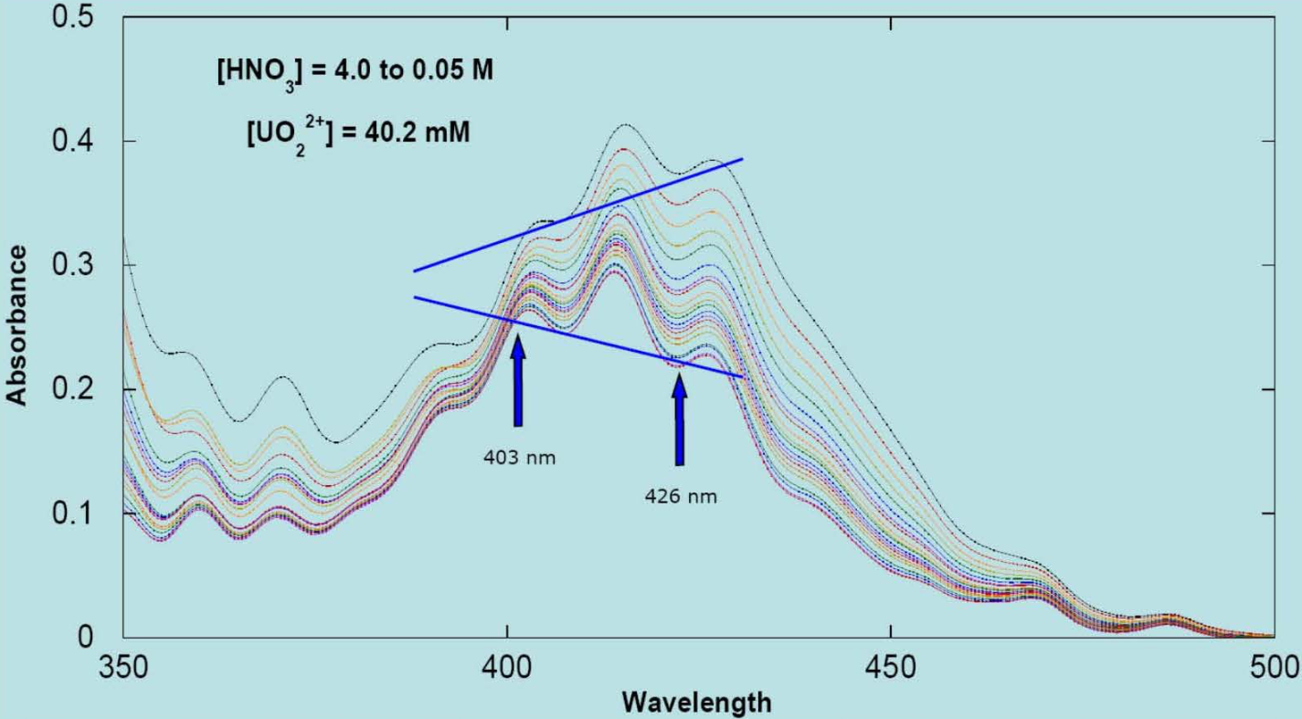
Optical Techniques: UV/Vis Spectroscopy (for Process Monitoring)
Notes:
An important safeguards challenge is to perform real-time process monitoring in aqueous reprocessing, which is a very hostile and challenging environment.
Laser based UV/visible spectroscopy may help in this area by providing a non-contact method for assaying chemical species in solution.
This plot shows the UV/Vis spectrum of UO2 (features at 403 nm and 426 nm) for varying nitric acid strengths.
Data like this can be used to assay the uranyl concentration in aqueous processes in near real-time.
Taken from “Fuel Cycle Separations Group: An Overview”

Slide 21
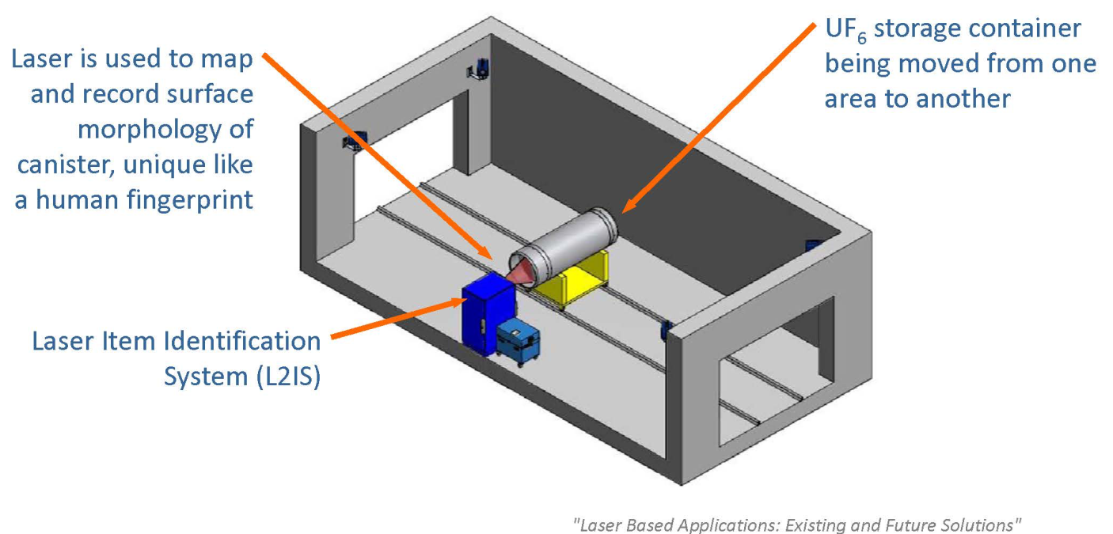
Laser Surface Profiling
Notes:
More sophisticated optical inspection tools are under development, including a laser identification tool to detect signs of tampering and to be sure items are correctly labeled and have not been switched.

Slide 22
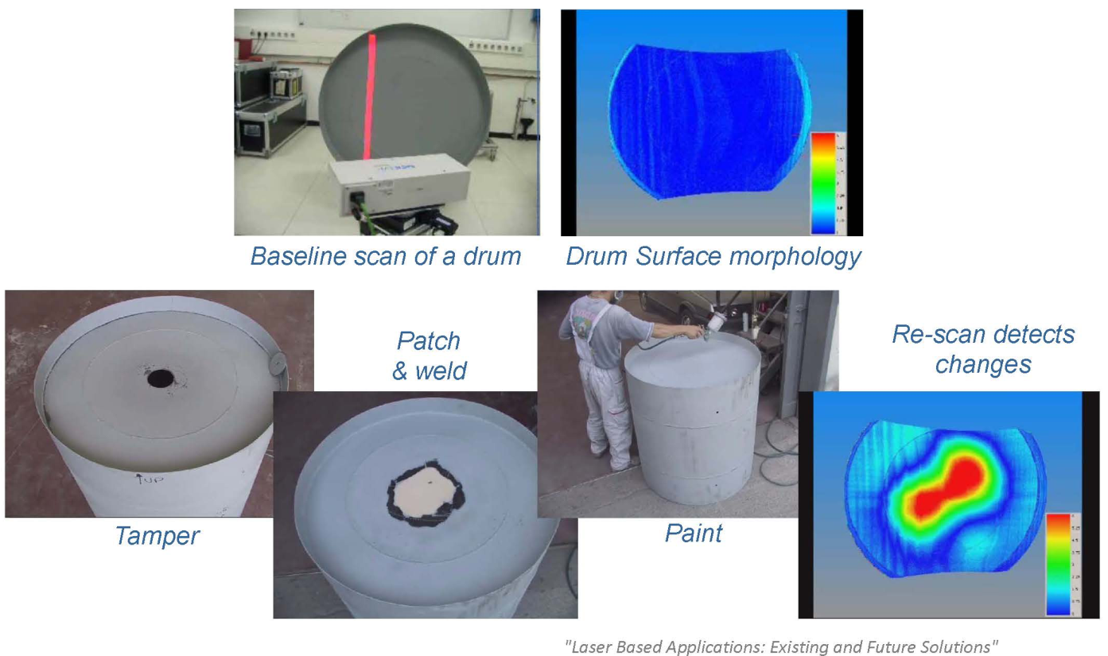
Laser Surface Profiling Example
Notes:
Here is an example of detection of tampering with a storage drum using laser surface mapping.

Slide 23
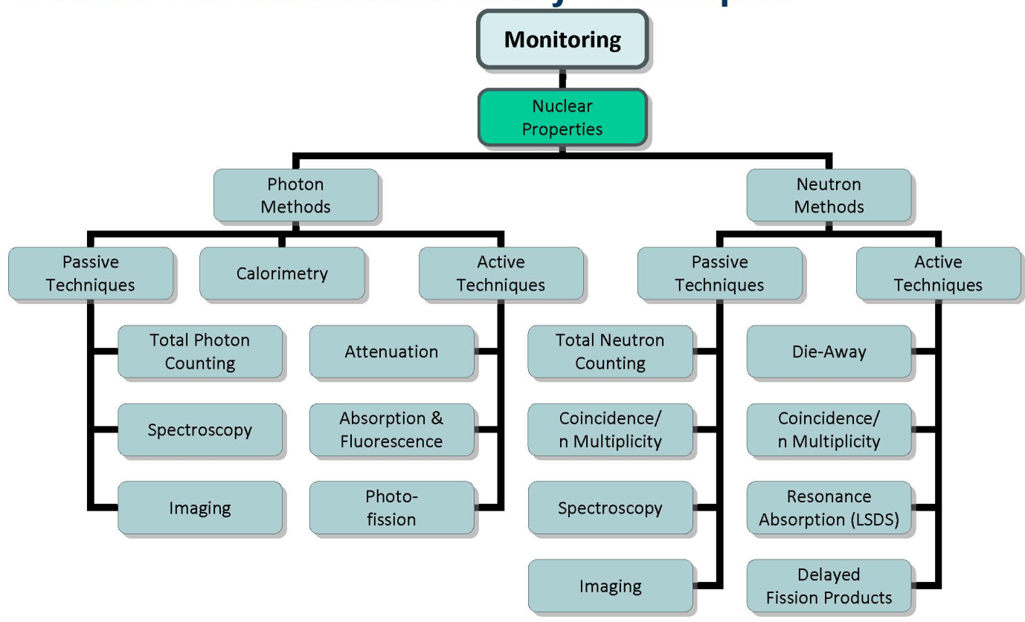
NDA Techniques

Slide 24
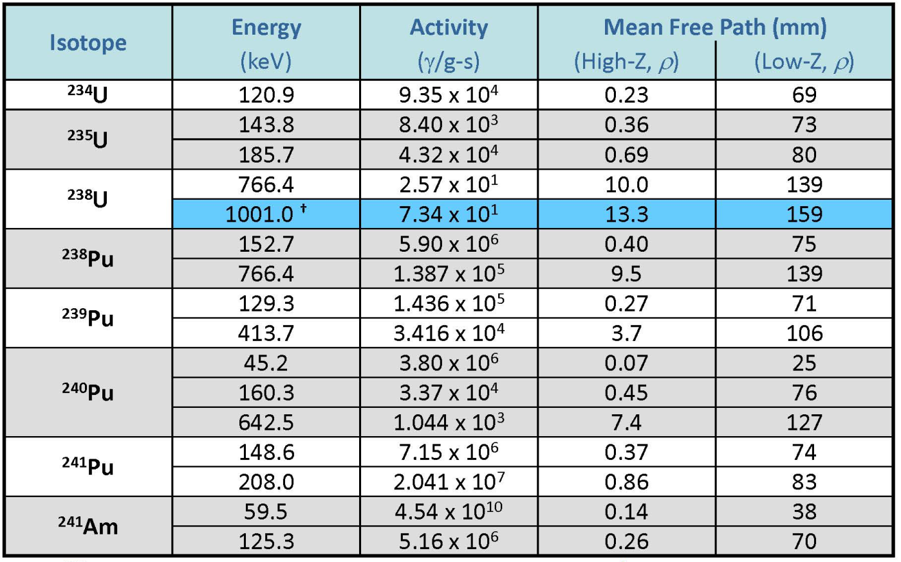
Passive Gamma Ray Signatures
Notes:
What is the 1001 signature from?
The decay of the daughter product ^{234m}Pa
Note these materials are dense so self-shielding is not negligible
Taken from ”PANDA”

Slide 25
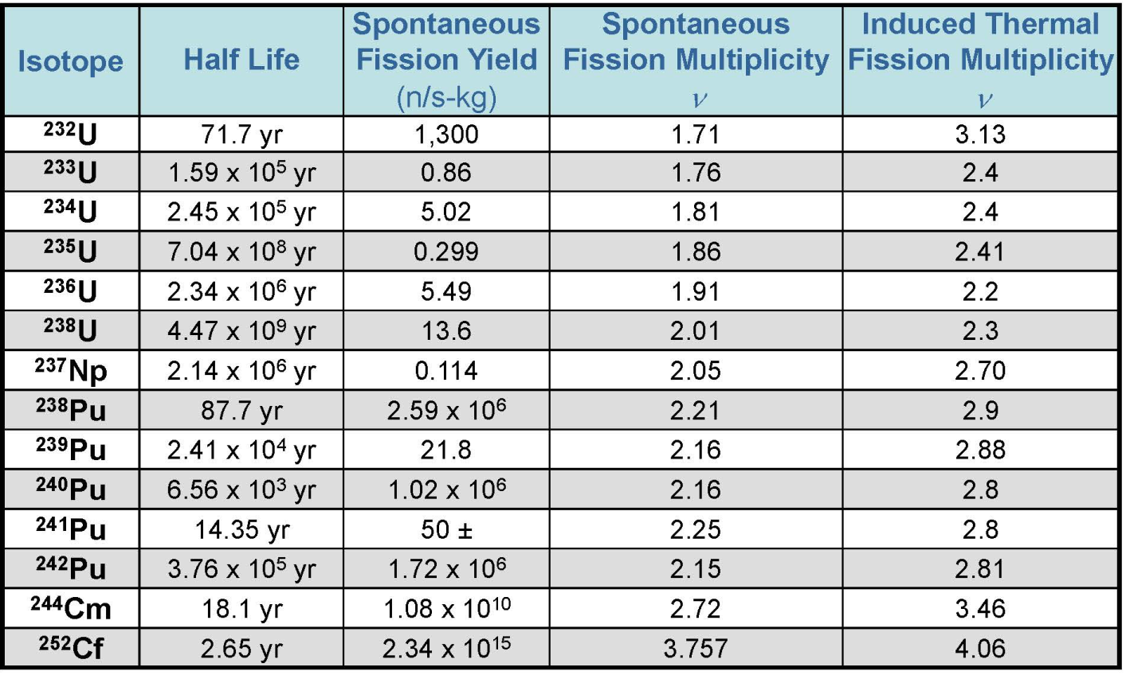
Passive Neutron Signatures
Notes:
Taken from PANDA

Slide 26
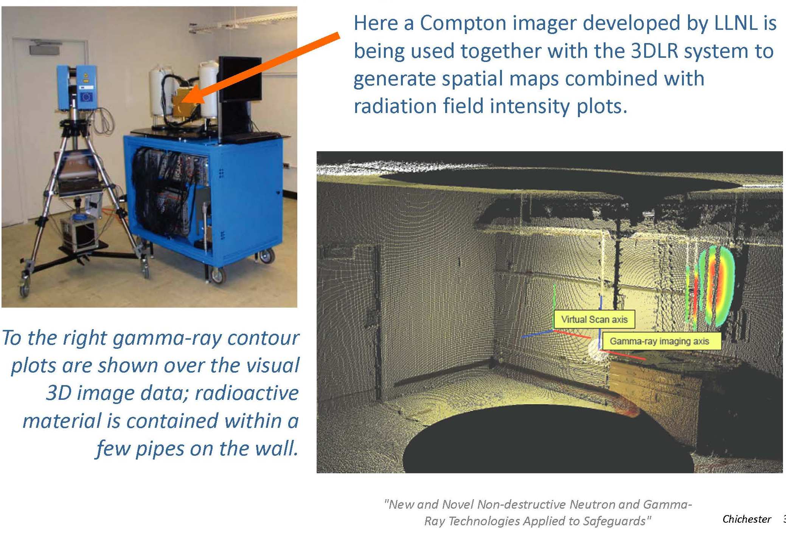
3DLR + a Gamma Ray Imager

Slide 27
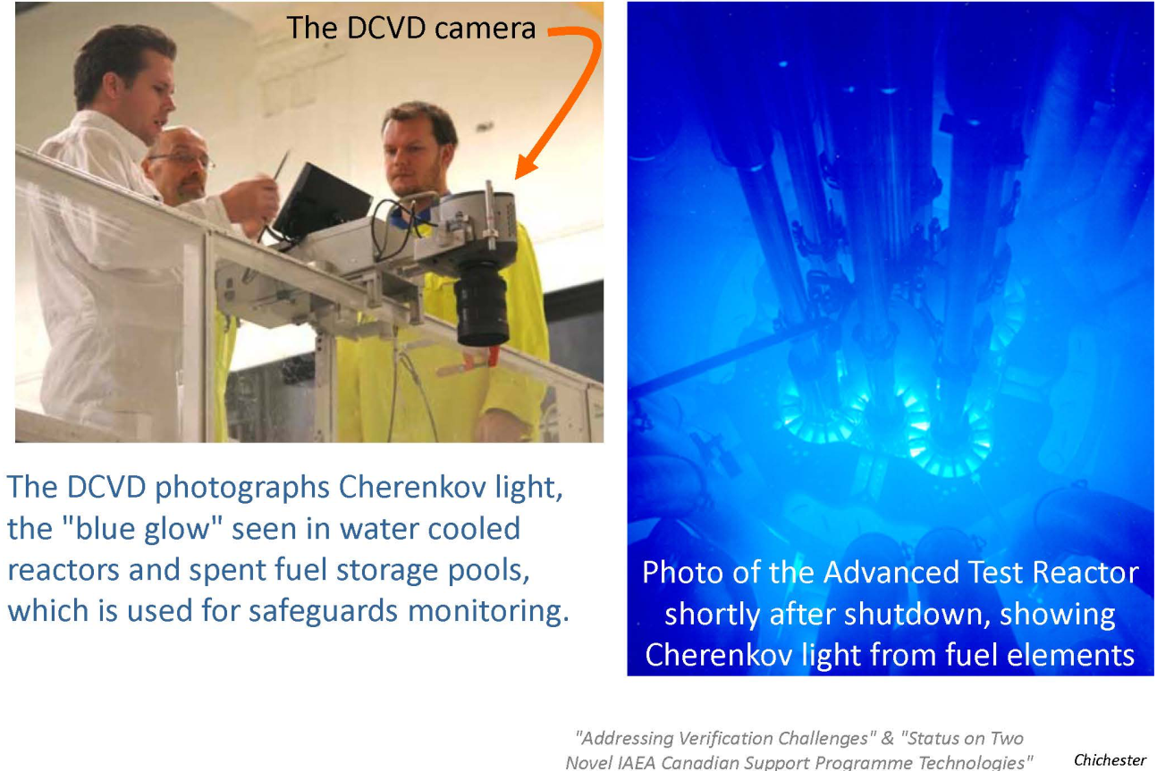
Digital Cherenkov Viewing Device
Notes:
What is Cherenkov radiation?

Slide 28
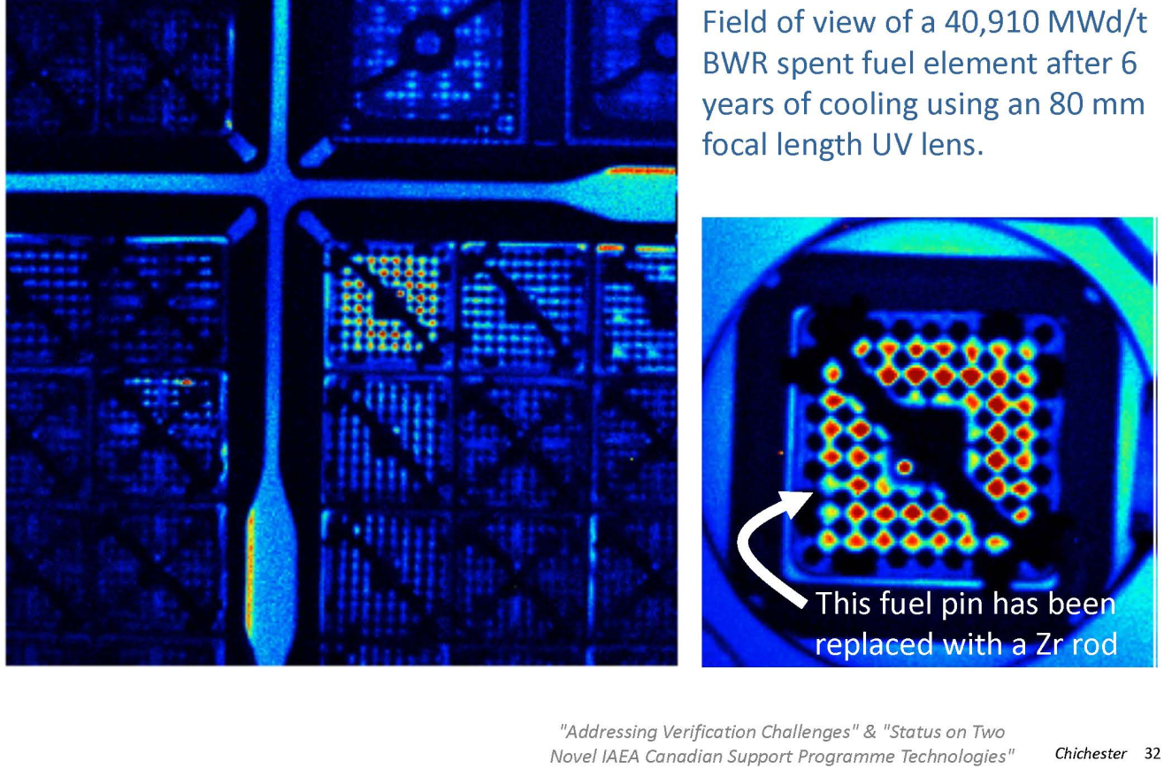
DCVD Images

Slide 29
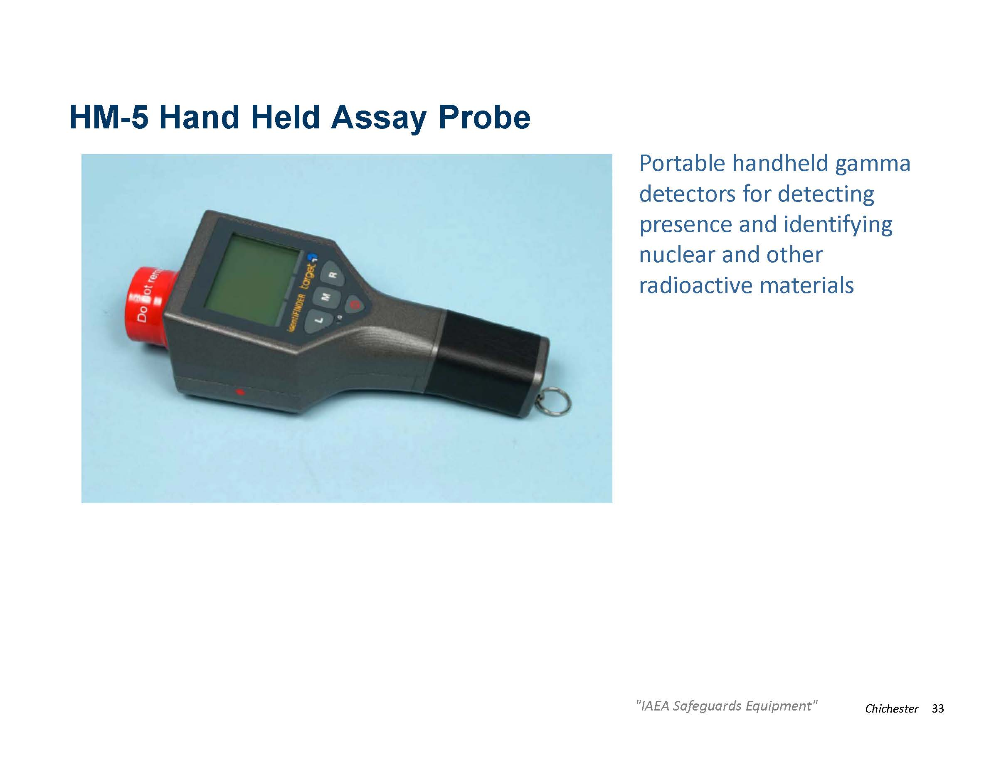

Slide 30
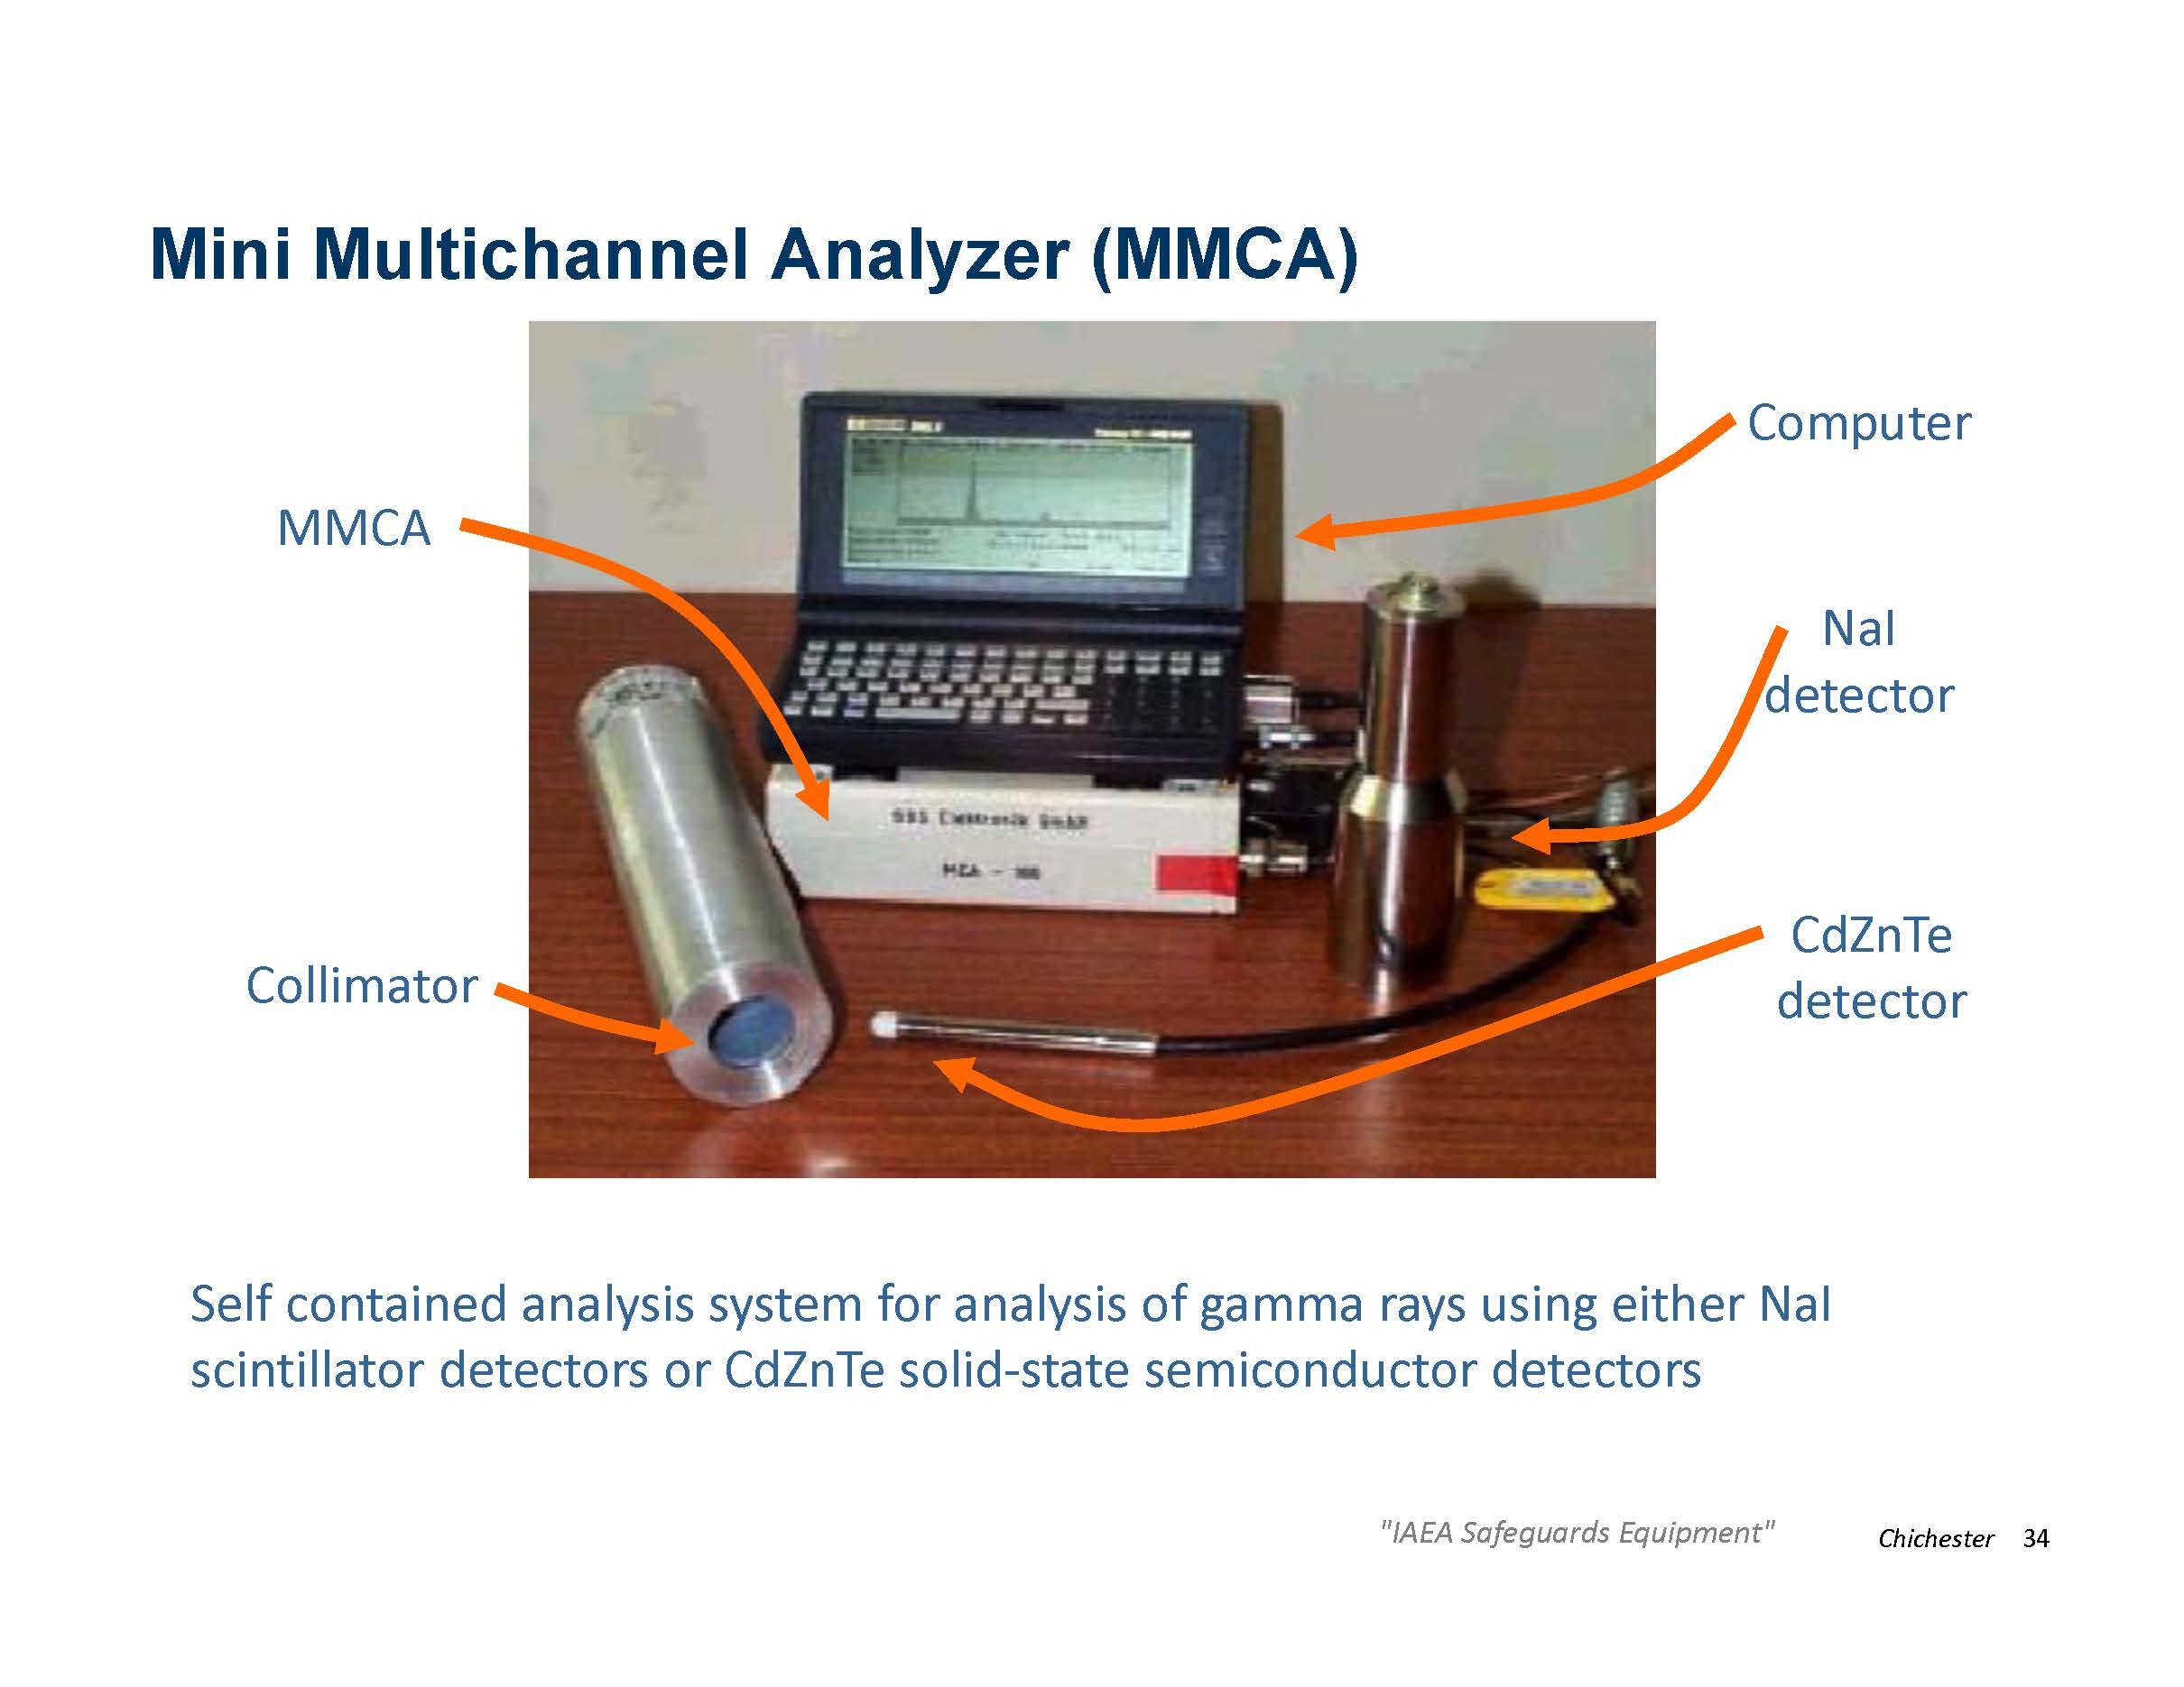

Slide 31
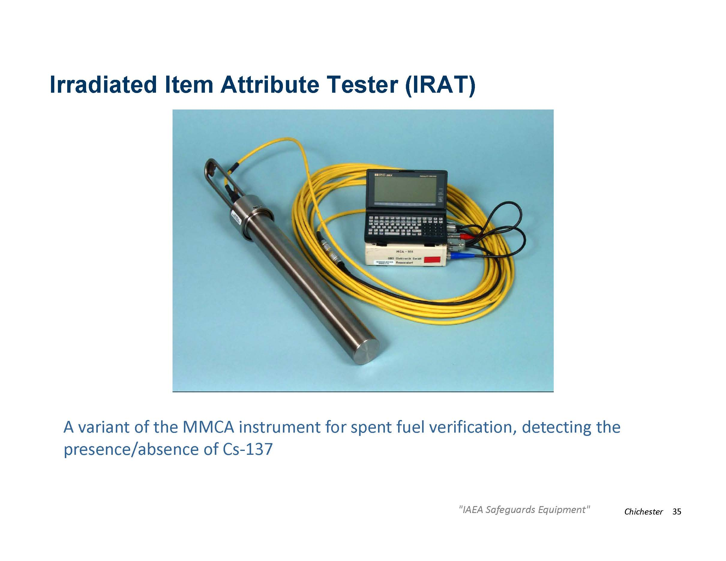

Slide 32
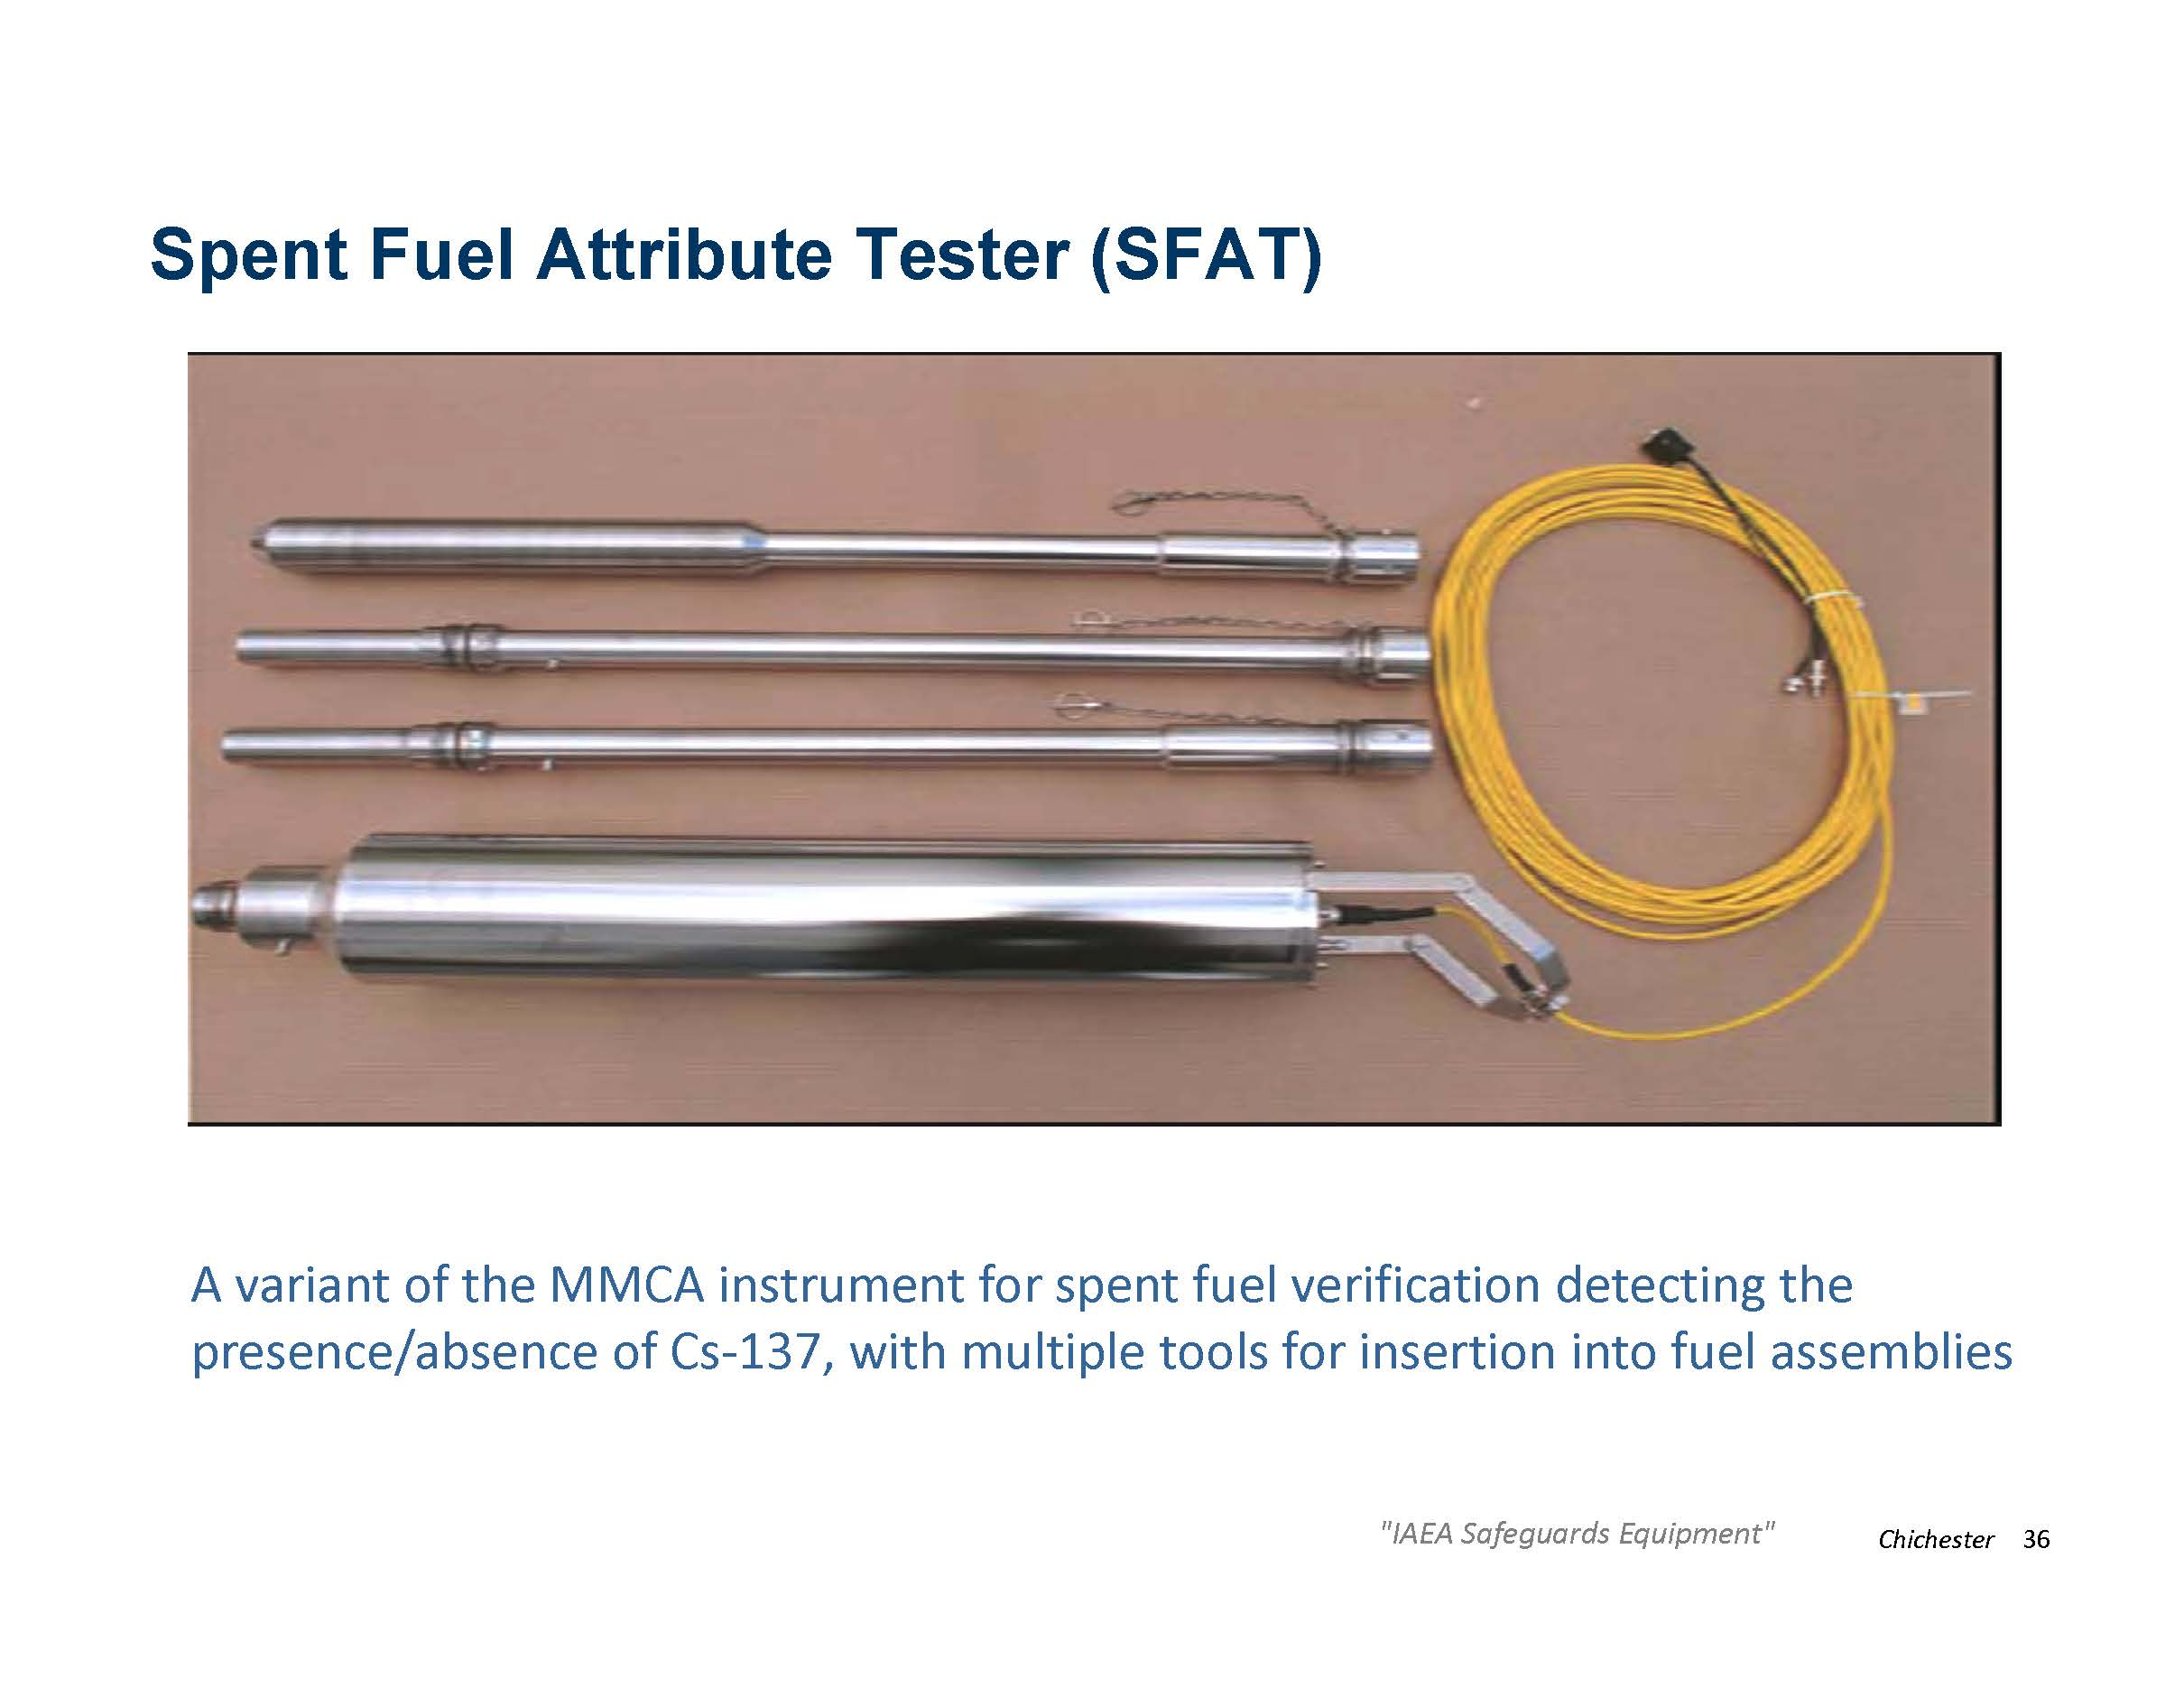

Slide 33
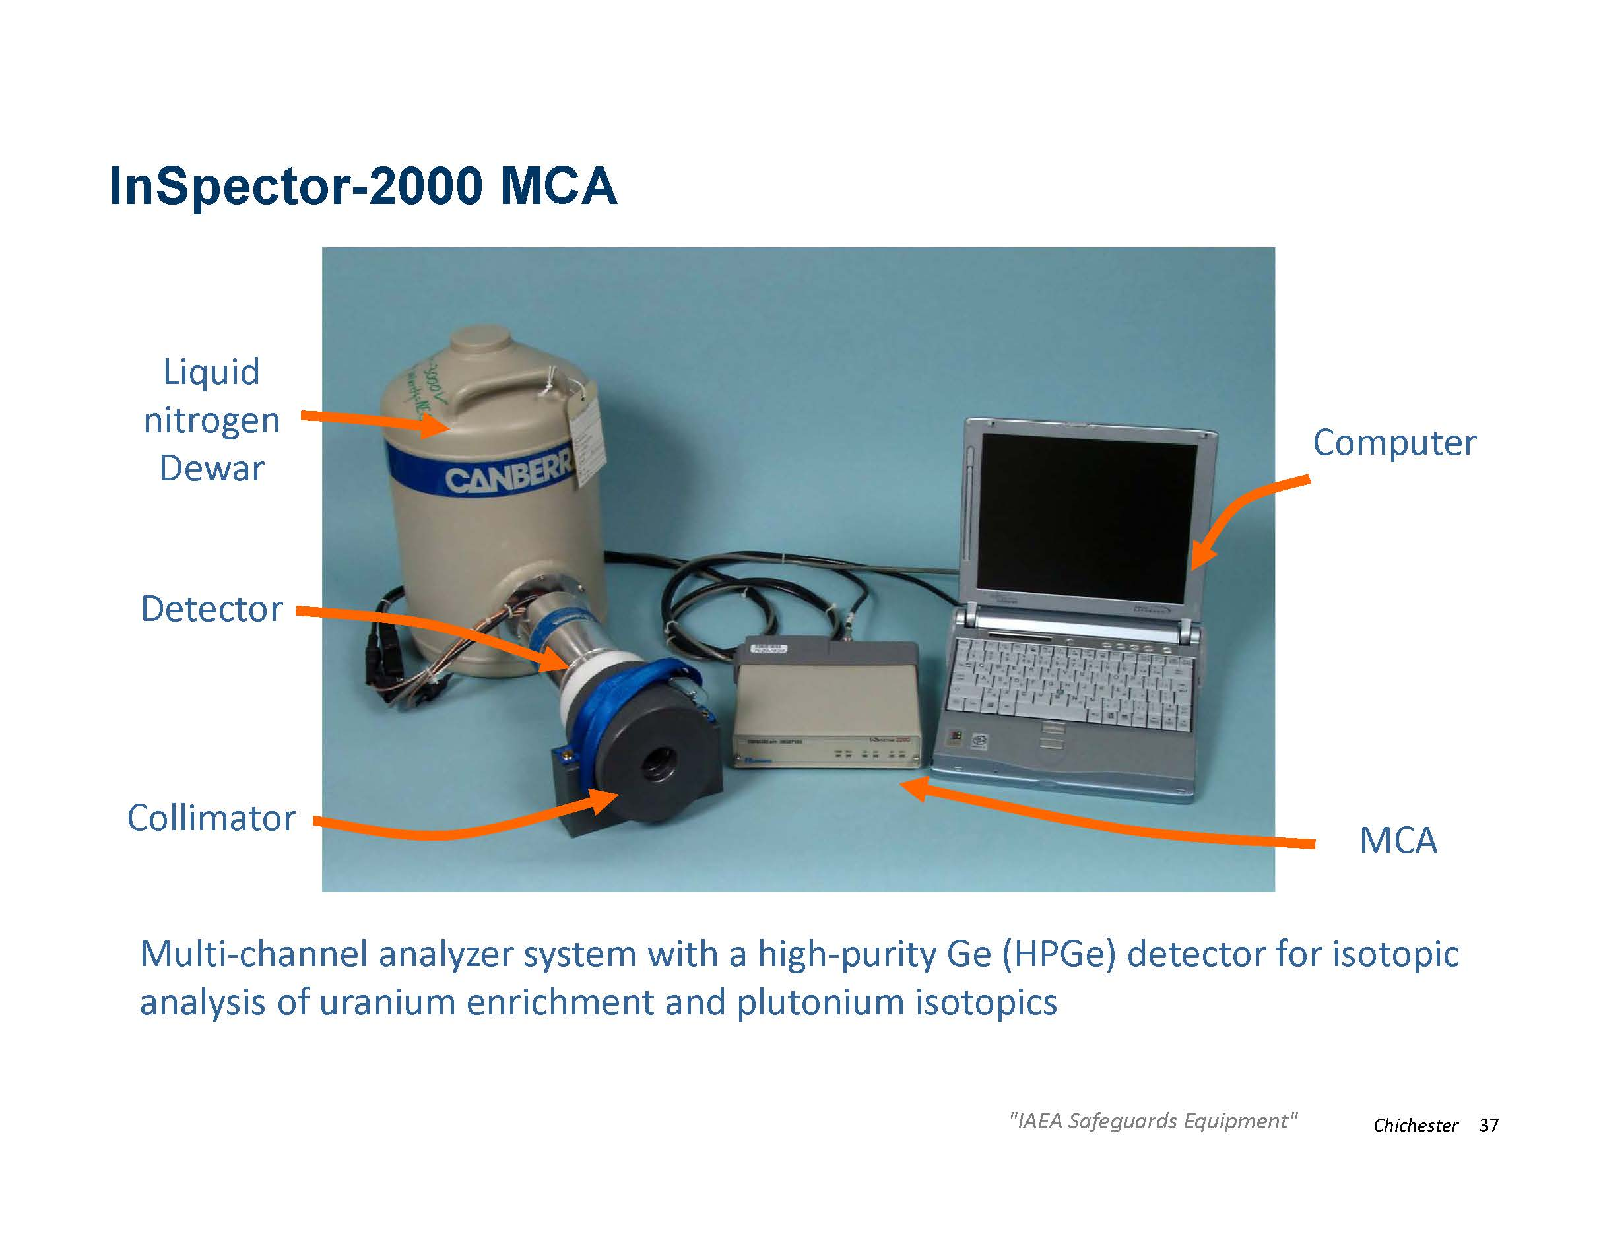

Slide 34
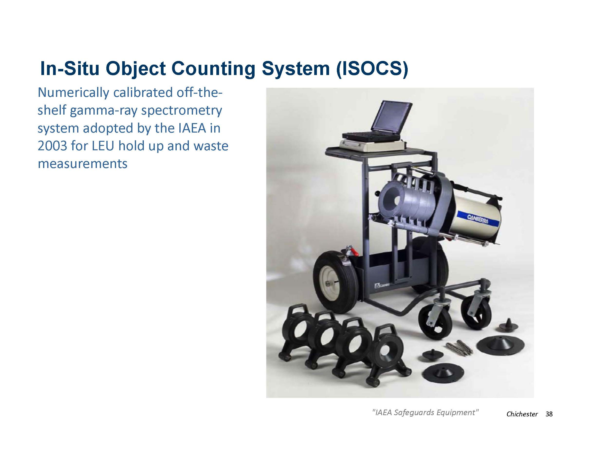

Slide 35
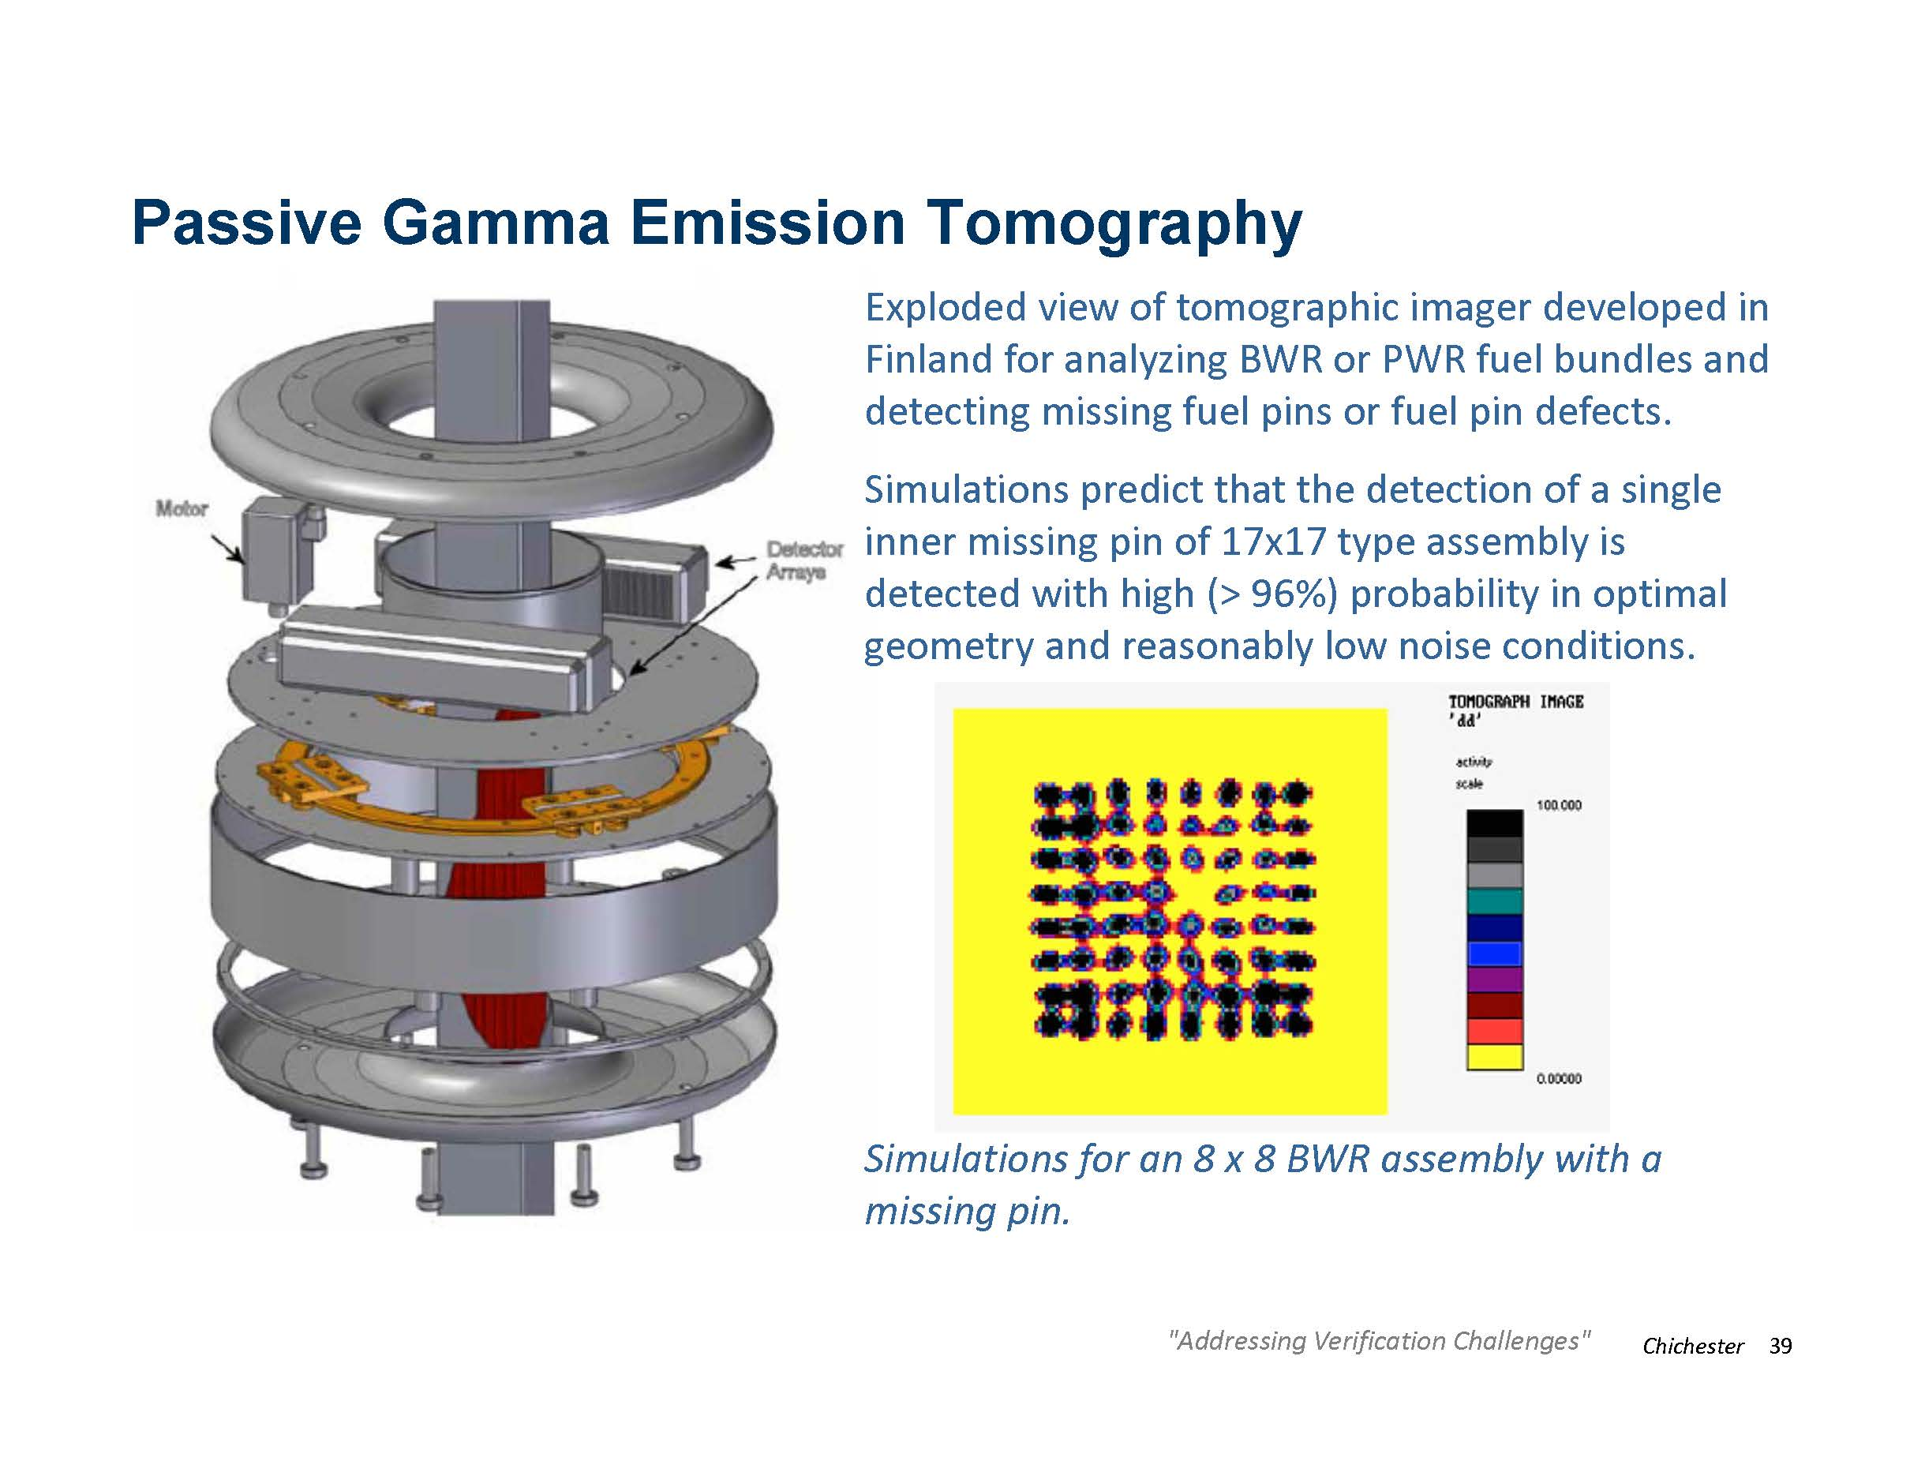

Slide 36
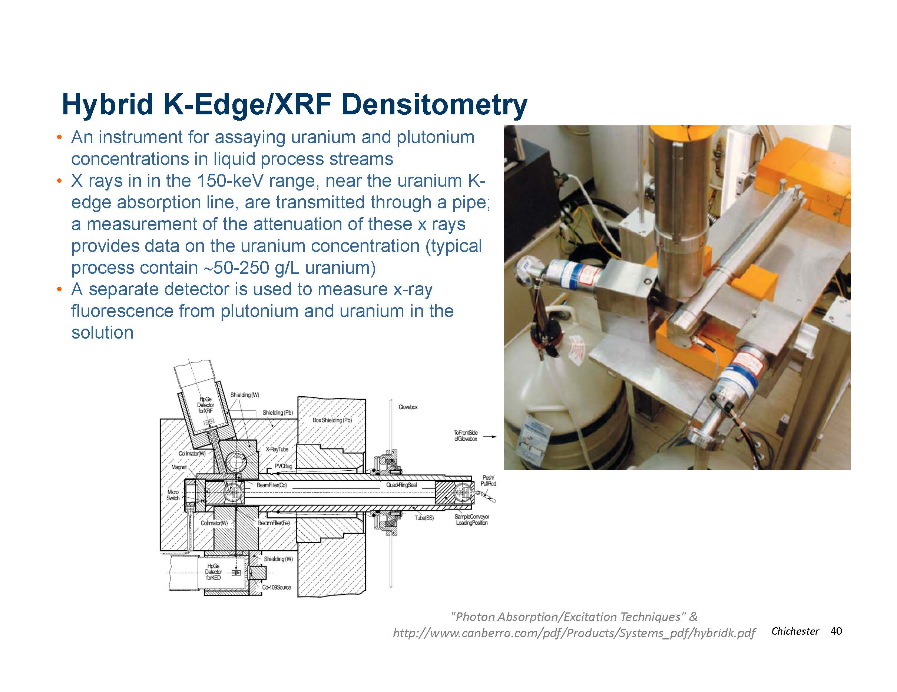

Slide 37
Calorimetry
What is calorimetry?
Calorimetry assays are independent of sample geometry, nuclear material distribution in the sample, and matrix material composition.
Heat standards are directly traceable to National Standards and plutonium standards are not needed.
The assay is comparable to chemical assay in precision and accuracy if the isotopic composition is well known
The assay is applicable to a wide range of material forms and plutonium can be measured in the presence of uranium.
Notes:
What is calorimetry?
A measurement of the thermal power of a sample.
Calorimetry can be used to quantify the mass of plutonium when additional details about the relative fraction of different plutonium isotopes is known.
From “Non Destructive Assay” esarda2.jrc.it/internal_activities/WC-MC/Web-Courses/07-NDA-Peerani.pdf

Slide 38
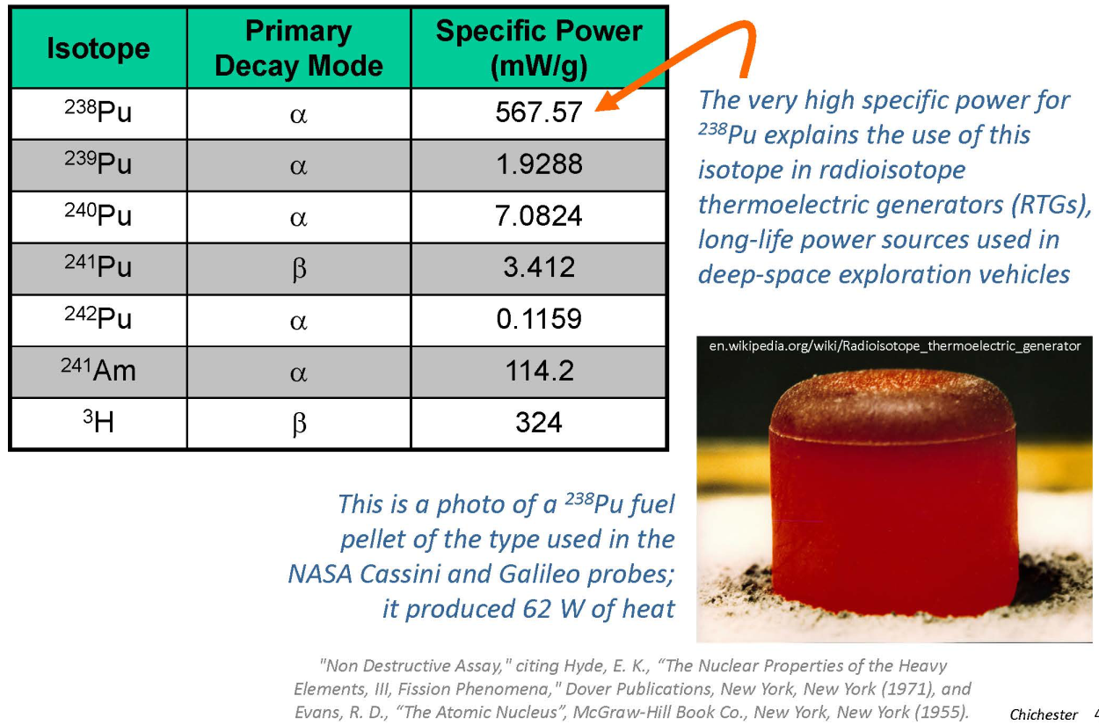
Specific Power of Key Isotopes

Slide 39
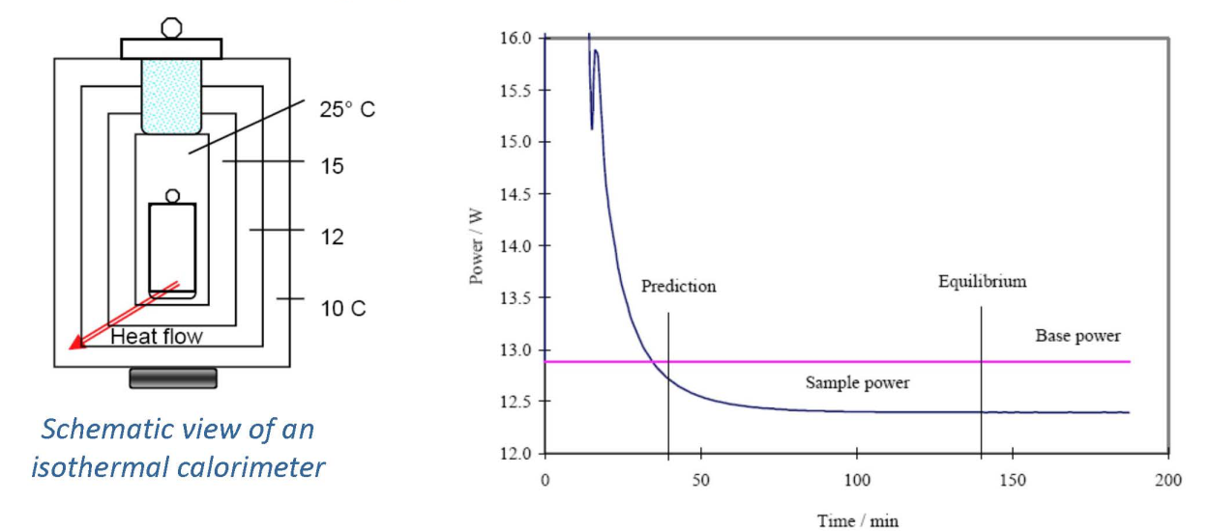
Calorimeter Equipment
How does it work?
Notes:
How does it work?
First, the empty calorimeter is heated and the power required to maintain a particular equilibrium temperature level is determined (pink line).
Then a self-heating sample is placed inside the calorimeter and the new power level needed to maintain the same equiplibrium temperature is determined (blue line)

Slide 40
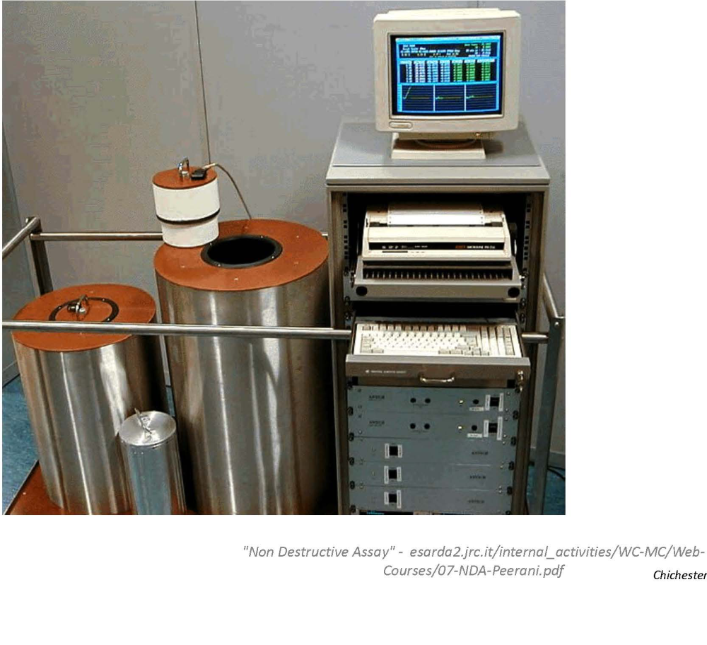
Plutonium Air-Flow Calorimeter

Slide 41
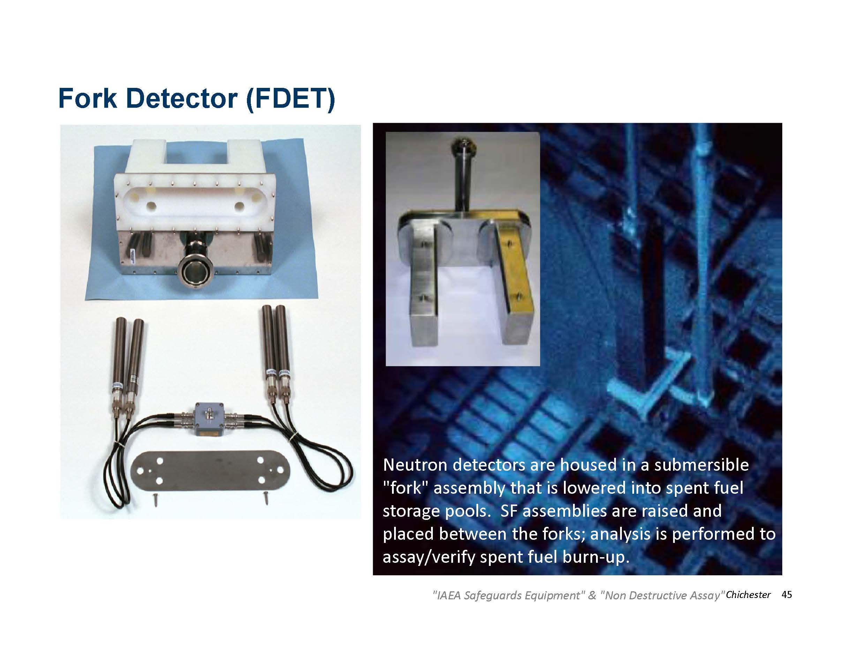

Slide 42
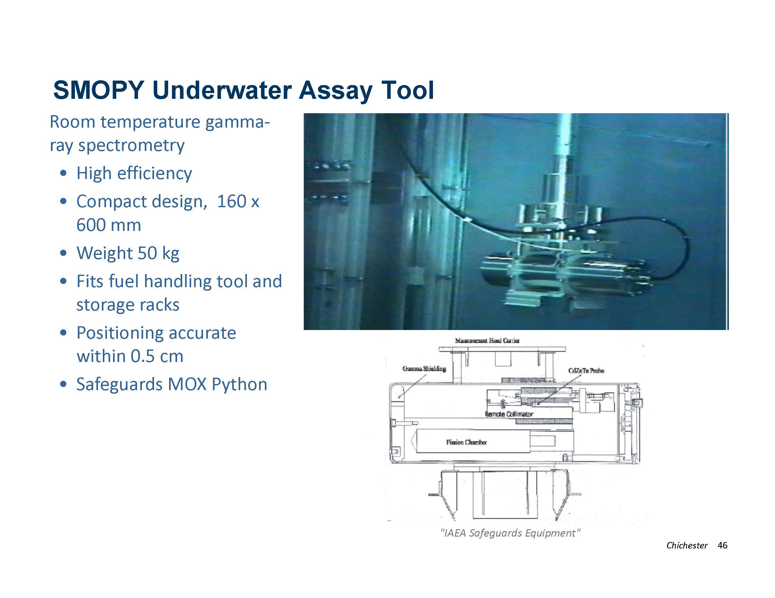

Slide 43
Neutron Coincidence & Multiplicity
Fission (spontaneous or induced) produces multiple neutrons per event—neutron multiplicity
Performing time-correlated measurements of neutrons from a test object can be used to distinguish fission neutrons from other neutron sources, such as the (alpha,n) neutron signature present in oxide fuels
If estimates of the plutonium isotopic distribution are available then “accurate” mass determinations may be made of the plutonium in the sample
Larger masses of fissionable material are subject to multiplication, which can produce “long-duration” chains of fission neutrons following a first neutron from either spontaneous fission or cosmic-ray produced neutrons

Slide 44
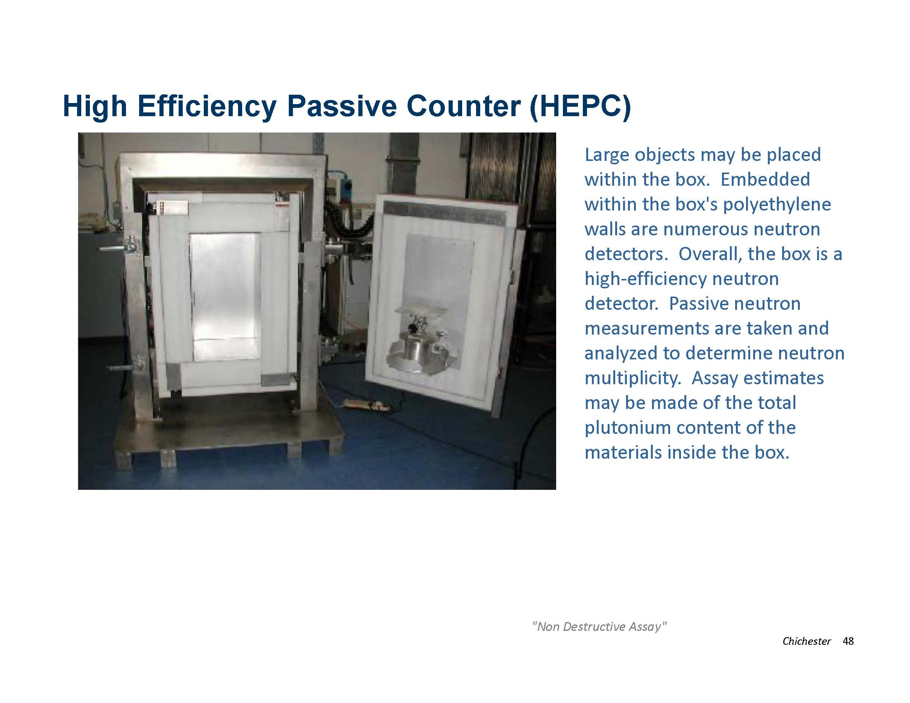

Slide 45
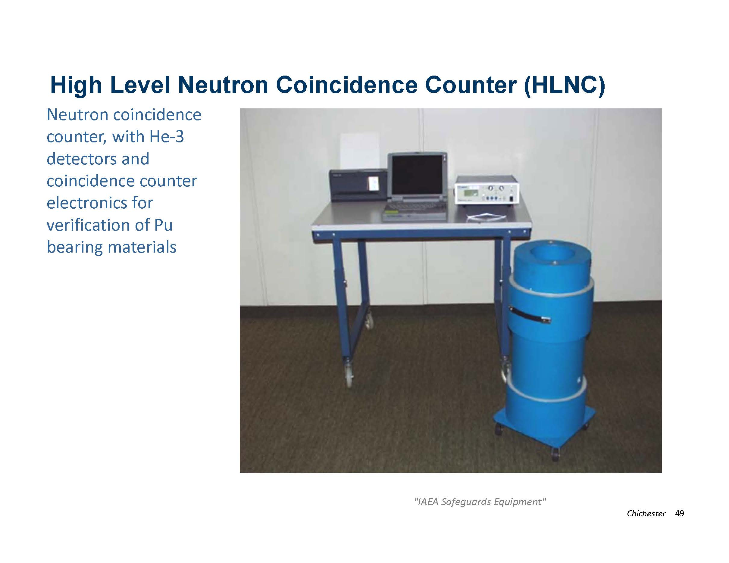

Slide 46
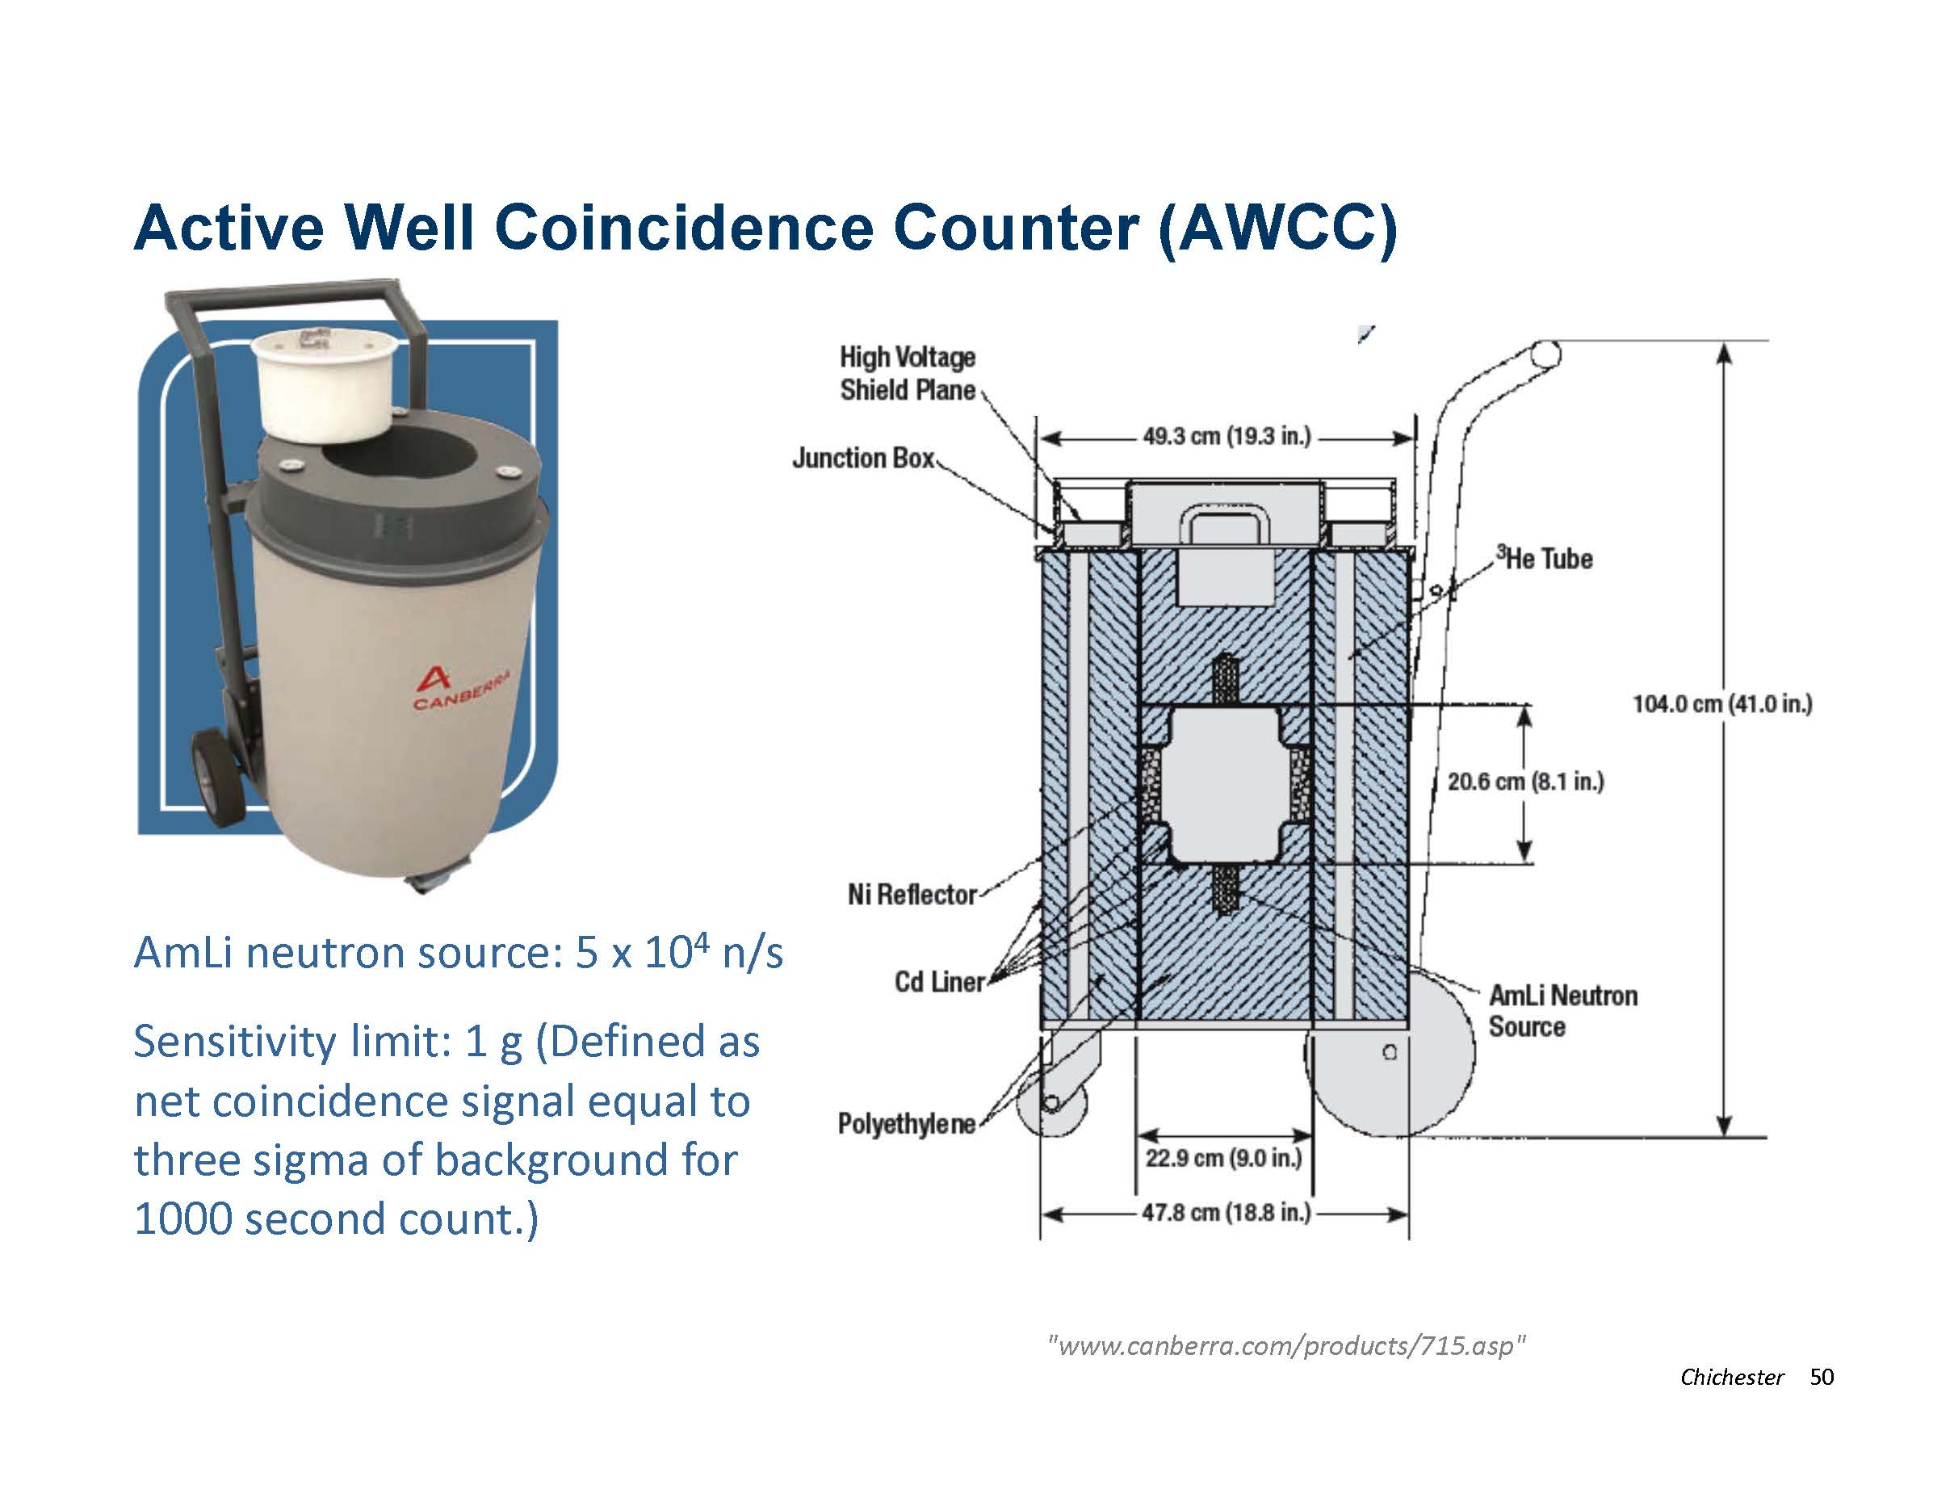

Slide 47
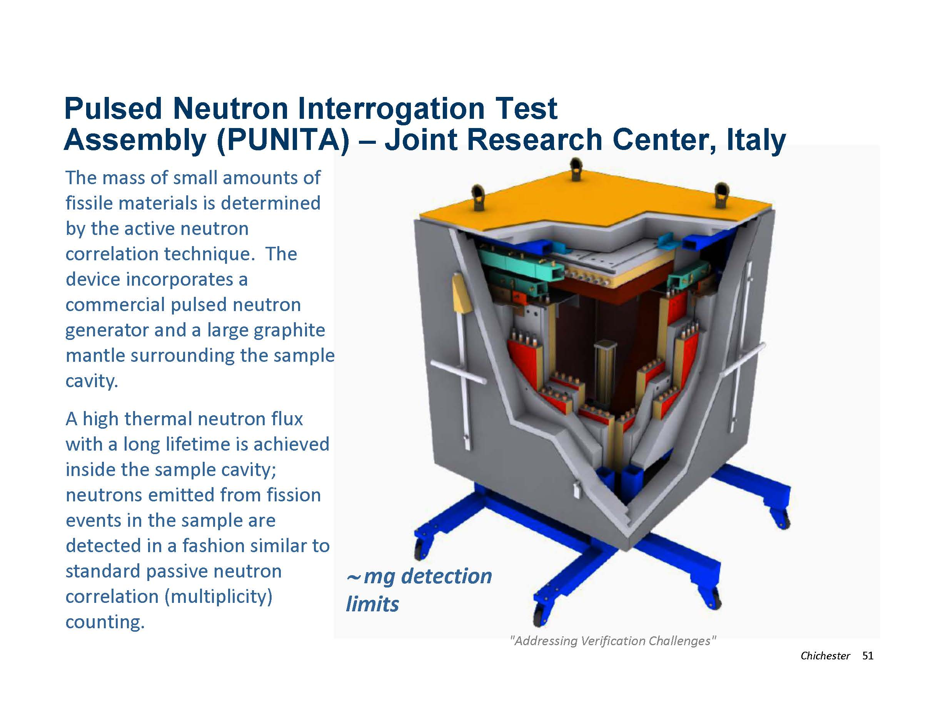

Slide 48
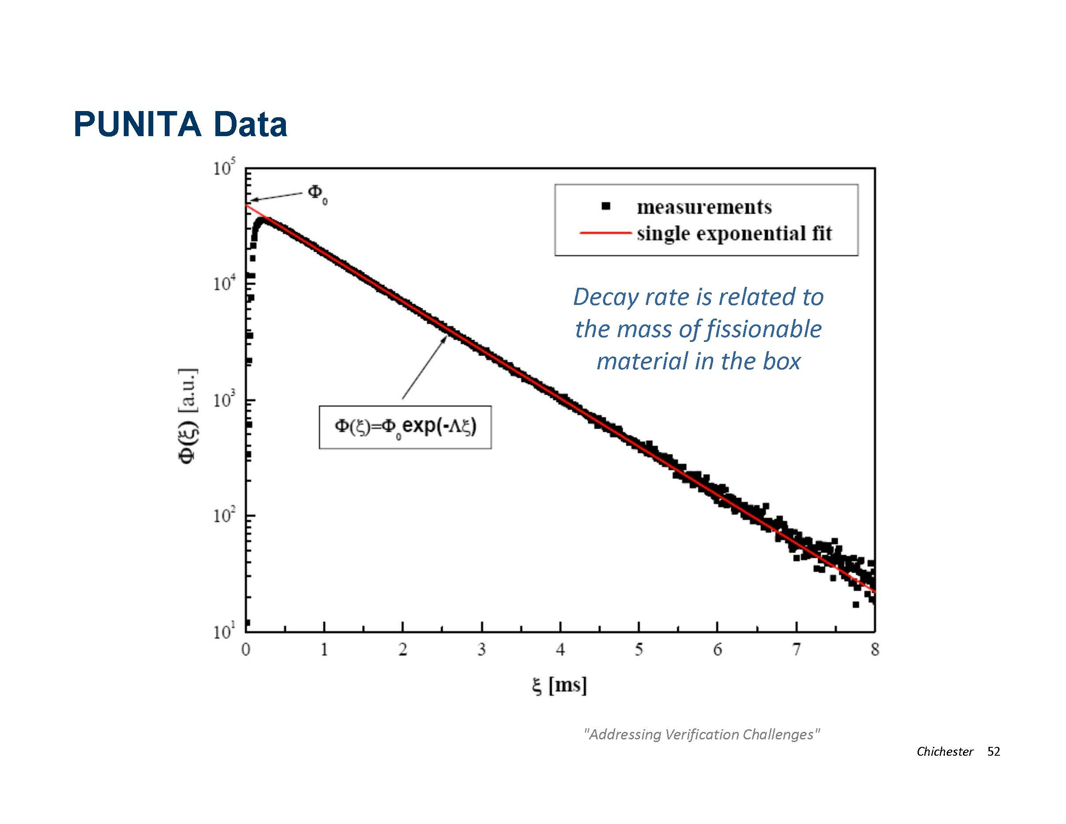

Slide 49
Other instruments for Safeguards
Beyond the examples shown (in this presentation) there are many other NDA tools used in support of the Safeguards mission.
Advances in nanotechnology, robotic systems, image analysis, remote sensing, sensor networks, human behavior studies, etc. may all be found useful towards improving the technological support to nonproliferation efforts in the future.

Slide 50
Summary
DA and NDA techniques provide a comprehensive, overlapping, and robust set of analytical tools to support Domestic and International Safeguards
Precision and Sensitivity
DA environmental analysis capabilities are a strong deterrence against violating safeguard agreements
NDA measurements have been developed to characterize and monitor many different components of the nuclear fuel cycle
The primary challenges with current implementation of DA and NDA safeguards are information overload and increases in material throughputs at facilities without commensurate reductions in inventory uncertainties.
Notes:
Precision and Sensitivity
DA measurements can achieve extreme levels of sensitivity and precision but often require more time and are more costly than NDA techniques
The primary challenges with current implementation of DA and NDA safeguards are information overload and increases in material throughputs at facilities without commensurate reductions in inventory uncertainties.
Everyday across the world hundreds of samples are collected for DA, hundreds / thousands of TV cameras are streaming data from facilities, and many NDA systems undergo evaluation for anomalies, alarms and signs of tampering
IAEA staff are inundate with information—what will be the consequence of world-wide nuclear power expansion on the international safeguards regime?
El Baradei in the Washington Post, 14 June 2006:
“In regard to nuclear proliferation and arms control, the fundamental problem is clear: Either we begin finding creative, outside-the-box solutions or the international nuclear safeguards regime will become obsolete.”

Slide 51
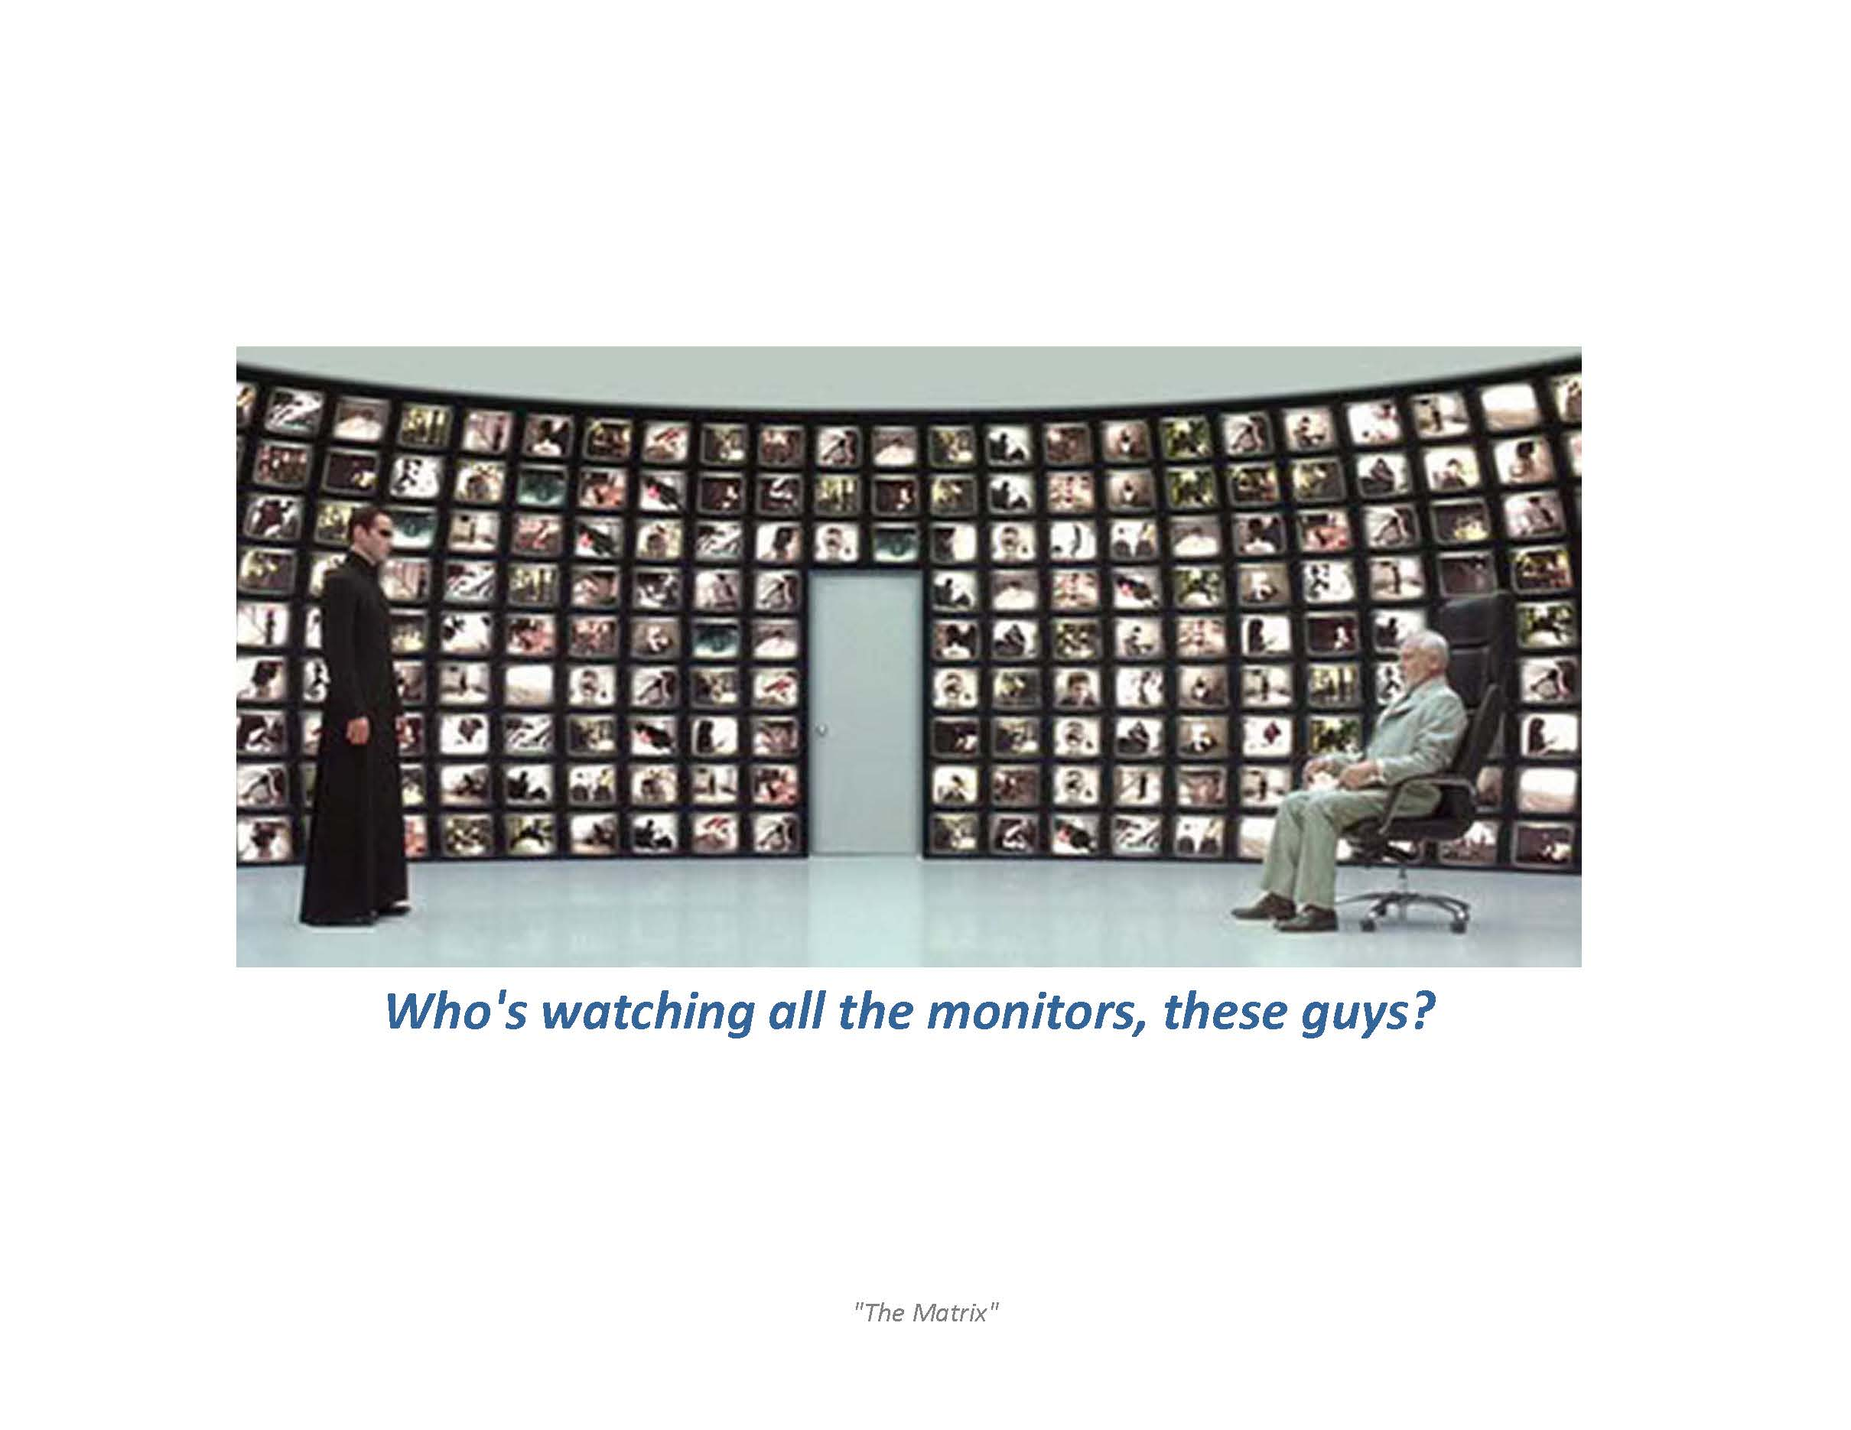

Slide 52
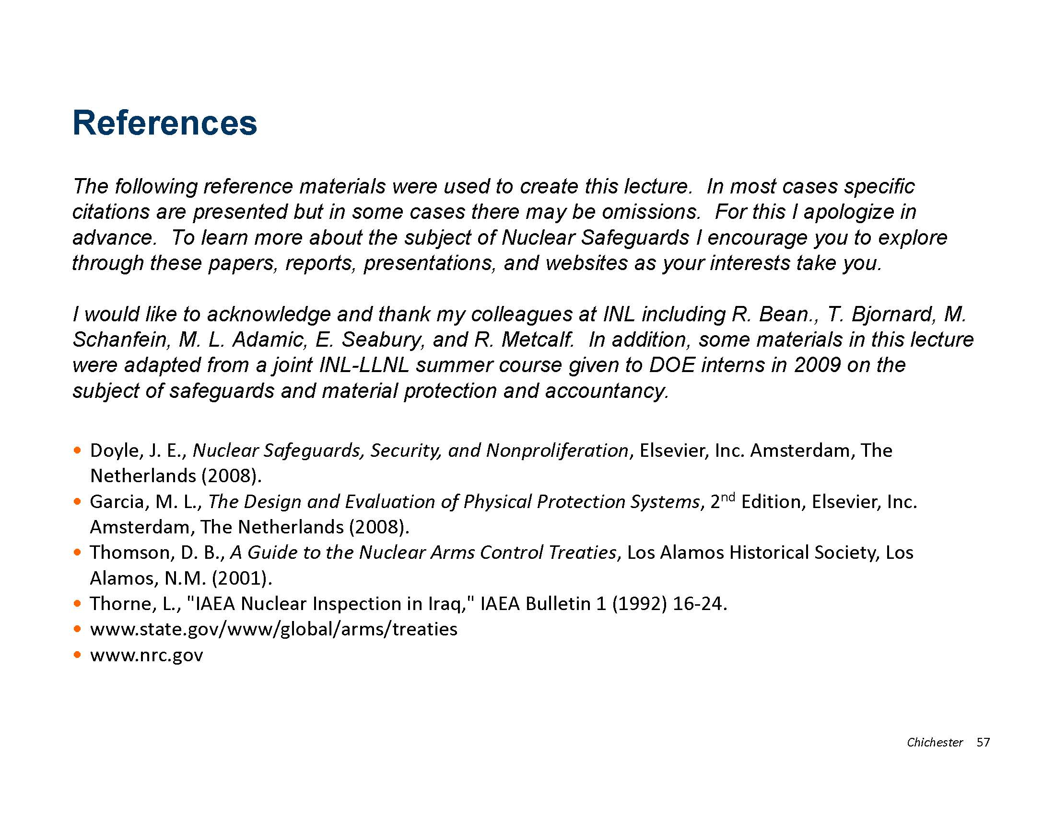

Slide 53
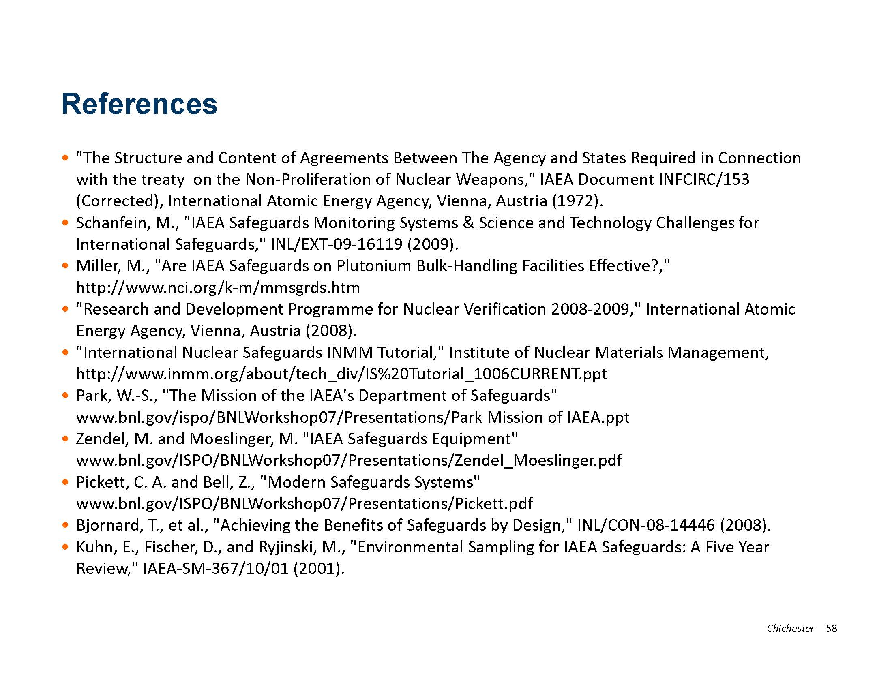

Slide 54
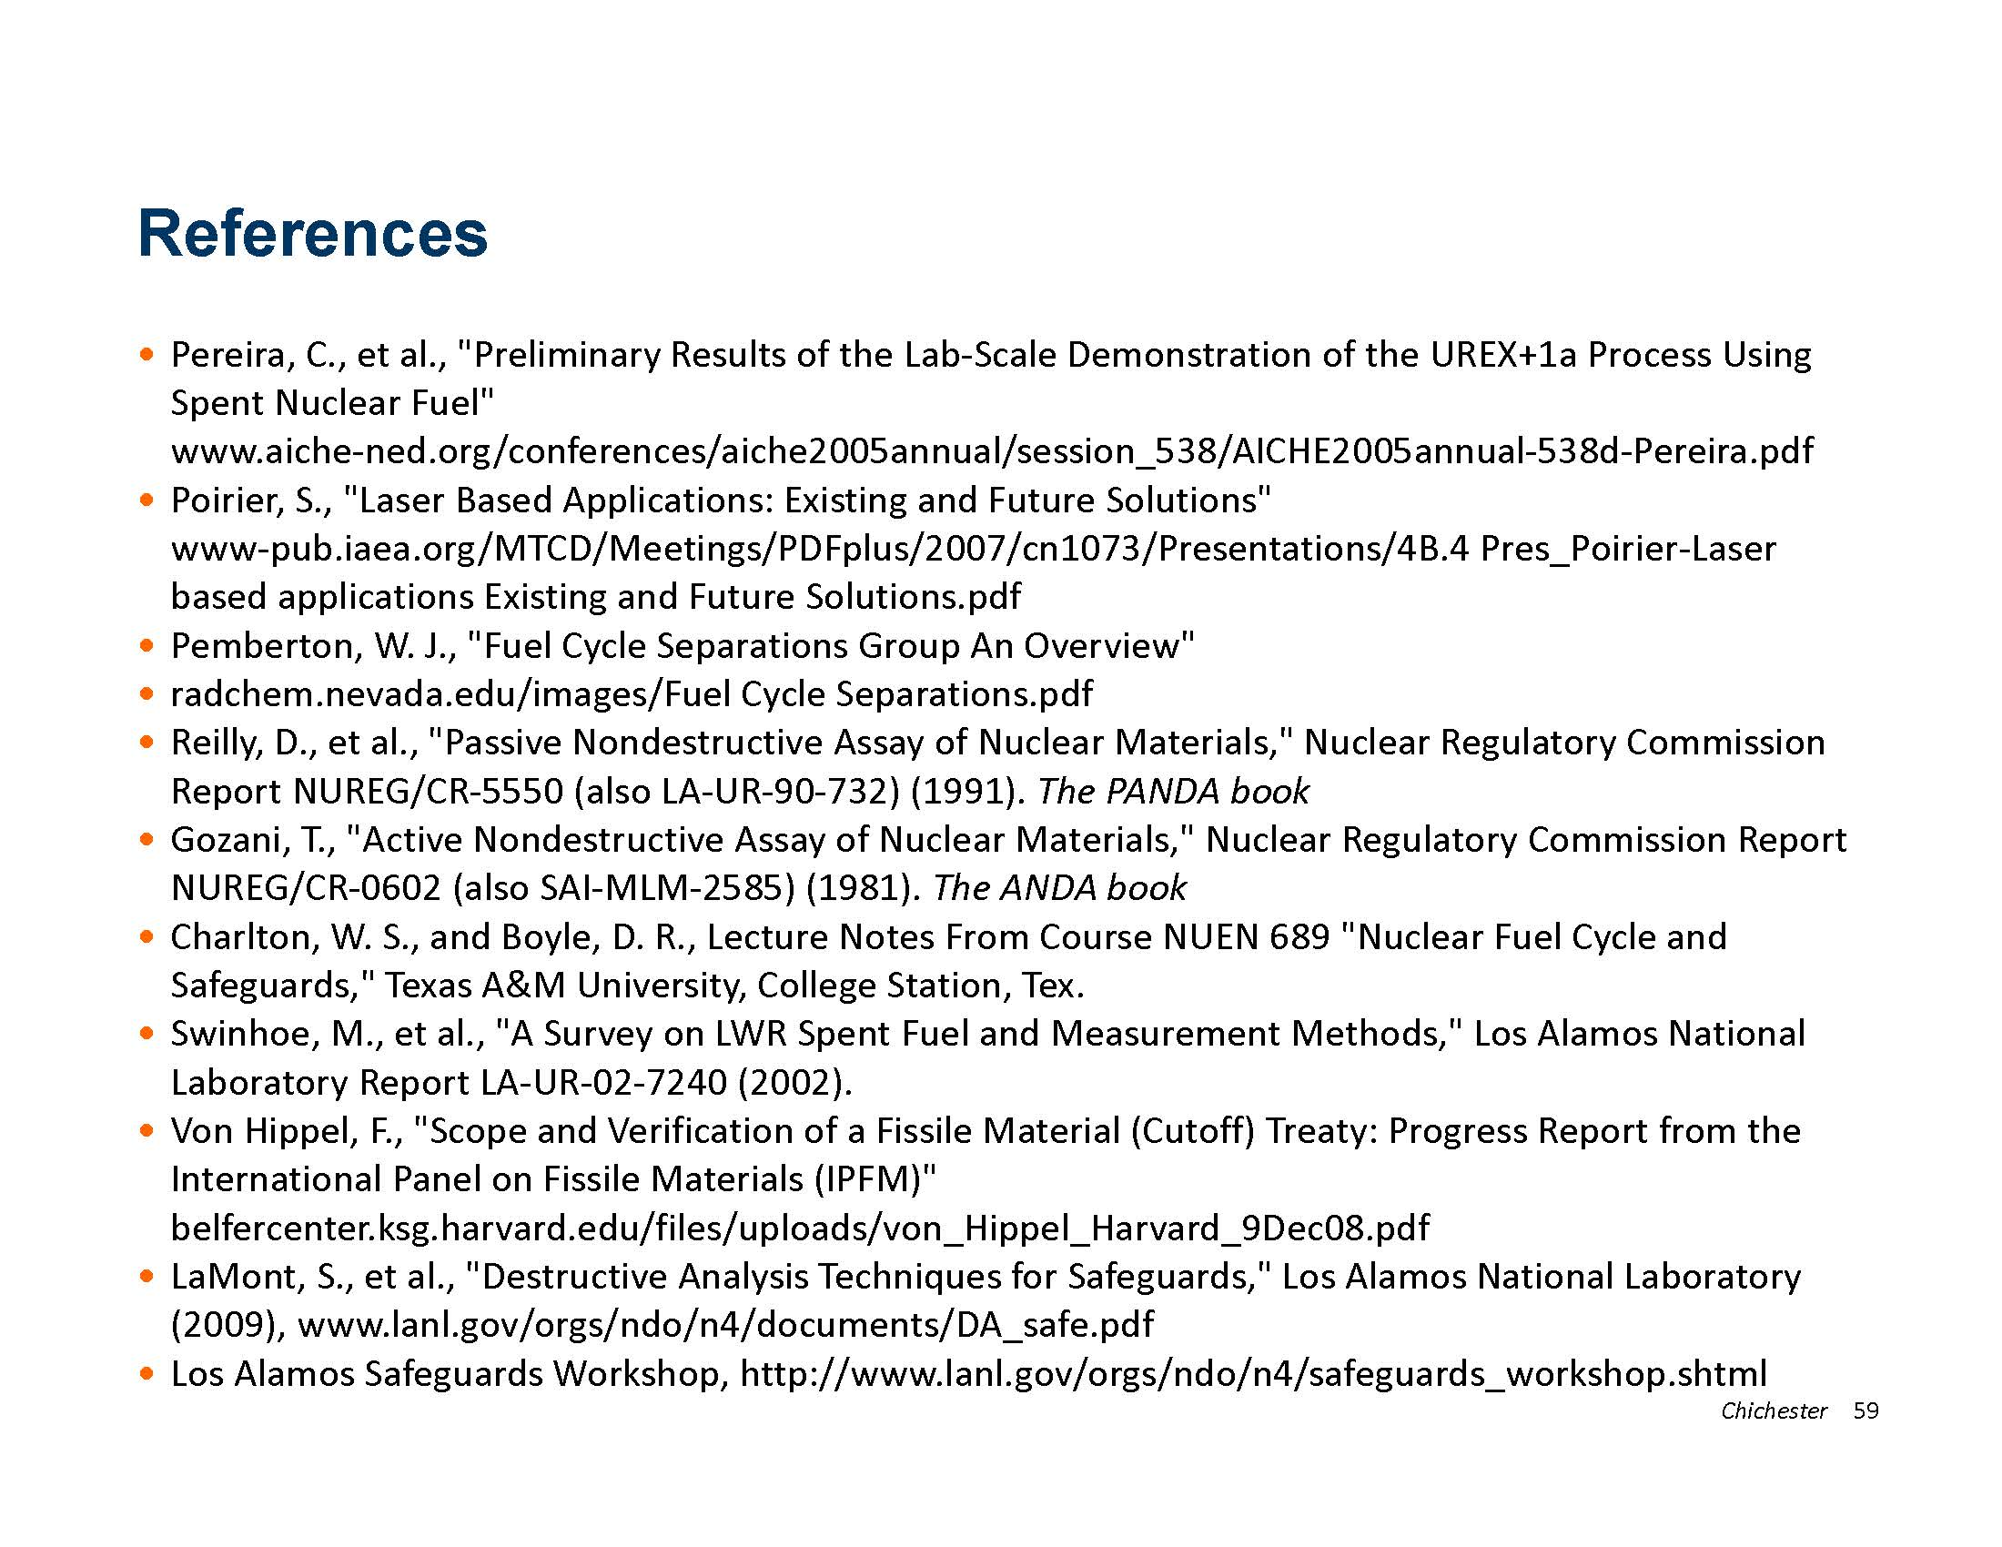

Slide 55
